Slide 1


ROP and CFI
SE3331-1 (2024 Fall)
IPADS, Shanghai Jiao Tong University
https://www.sjtu.edu.cn
Notes:
Credits to Mike Freedman (COS 461) and others.

Slide 2
2 Steps towards Building a More Secure System
How to make progress in building a secure system?
Be clear about goals: "policy"
Be clear about assumptions: "threat model"

Slide 3
Policy: Goals
Information security goals:
Confidentiality: limit who can read data
Integrity: limit who can write data
Liveness goals:
Availability: ensure service keeps operating

Slide 4
Threat Model: Assumptions
Often don't know in advance who might attack, or what they might do
Adversaries may have different goals, techniques, resources, expertise
Cannot be secure against arbitrary adversaries
As we saw with Ben vs. XYB
Adversary might be your hardware vendor, software vendor, administrator, …
Need to make some plausible assumptions to make progress

Slide 5
Authentication: Password

Slide 6
Authentication: Who Are You?
Something you know
E.g., passwords, answers of questions
Something you have
E.g., keys or smart cards
Something you are
E.g., fingerprint, iris, or other biometric method
Q: What are their pros and cons?

Slide 7
Authentication: Password
Password goals
Authenticate user
Adversary must guess
For random 8-letter passwords, ~26⁸?
Guessing is expensive

Slide 8
An Example: Guessing Password (Tenex)
checkpw (user, passwd):
acct = accounts[user]
for i in range(0, len(acct.pw)):
if acct.pw[i] ≠ passwd[i]:
return False
return True
passwd:
P
A
S
S
W
O
R
D
X
acct.pw:
P
A
S
S
w
O
R
D

Slide 9
Problem: Guess One Character at a Time
Guess a password
Allocate password 1 byte away from a page boundary
Page-fault means first char is OK
Example of cross-layer interactions
Problem: server has a copy of all passwords
If adversary exploits buffer overflow, can get a copy of all passwords

Slide 10
Timing Attack: Guess One Character at a Time
Guess a password
Allocate password 1 byte away from a page boundary
Page-fault means first char is OK
Example of cross-layer interactions
Also known as "Timing Attack"

Slide 11

Timing Attack: Guess One Character at a Time
Page in Memory
a
b
c
ca
…
cs
…
Page on Disk -> Page Fault
aaaaaa
aaaaaa
aaaaaa
aaaaa
aaaaa
Time = 1ms
Time = 1ms
Time = 10ms
Time = 1ms
Time = 10ms
Page Fault!
The 1st char must be 'c'
Page Fault!
The 2nd char must be 's'

Slide 12
Idea: Store Hash of Password
Hash functions: arbitrary strings to fixed-length output
Common output sizes are 160 bits, 256 bits, ..
One-way: given H(x), hard to recover x
Collision-resistant: hard to find different x and y such that H(x)=H(y)
Evolve over time: SHA-0 and MD-5 used to be popular, now considered broken

Slide 13
Store Hash of Password
Accounts database stores hash of every user's password
Compute hash, check if the hash matches
Solves not only the password theft problem, but also the page-fault attack

Slide 14
Store Hash of Password
username | hash(password) arya | de5aba604c340e1965bb27d7a4c4ba03f4798ac7
jon | 321196d4a6ff137202191489895e58c29475ccab
Sansa | 6ea7c2b3e08a3d19fee5766cf9fc51680b267e9f
hodor | c6447b82fbb4b8e7dbcf2d28a4d7372f5dc32687
check_password(username, inputted_password):
stored_hash = accounts_table[username]
inputted_hash = hash(inputted_password)
return stored_hash == inputted_hash

Slide 15
Store Hash of Password
What happens if an adversary breaks into a popular web site with 1M accounts?
Adversary steals 1M hashes
Problem: adversary can guess each password one-by-one
Problem: worse yet, adversary can build table of hashes for common passwords
Often called a "rainbow table"
Users are not great at choosing passwords, many common choices

Slide 16
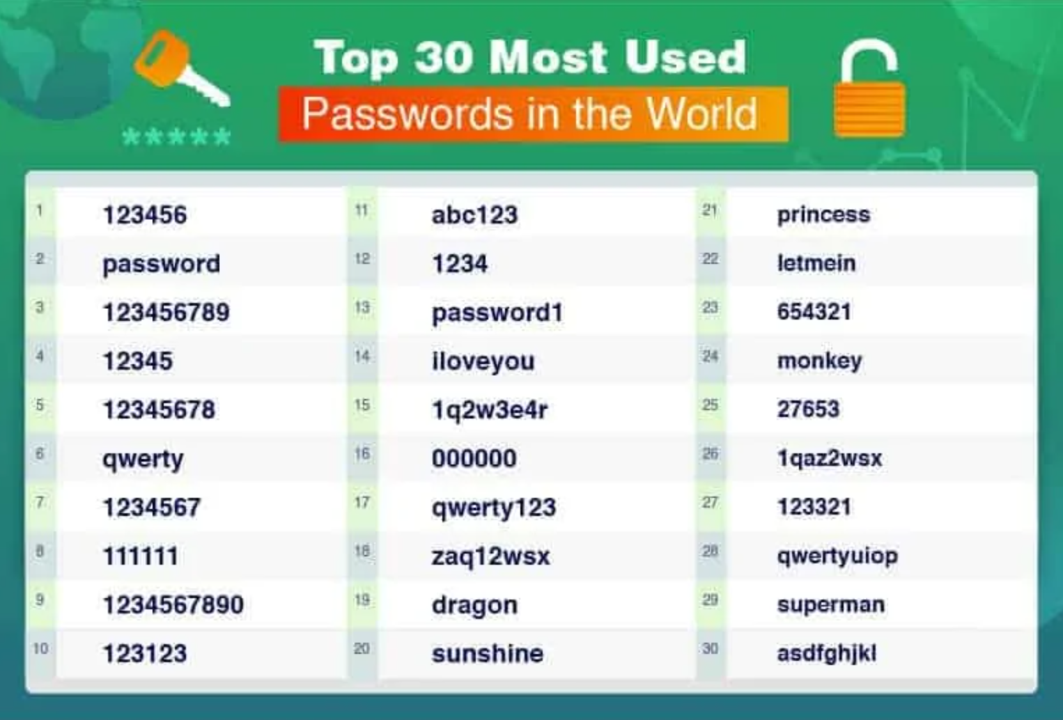
30 Most Used Passwords in 2022

Slide 17
Store Hash of Password
Important to think of human factors when designing security systems
Not much we can do for users that chose "123456"
Plenty of bad passwords have numbers, uppercase, lowercase, etc.
What matters is the (un)popularity of a password, not letters/symbols
But we can still make it a bit harder to guess less-embarrassing passwords

Slide 18
Salting
Salting: make the same password have different hash values
Makes it harder to build a pre-defined lookup table
Choose random salt value when storing the password (& store the salt)
Store hash of salt and password together
Use the original salt to compute a matching hash when verifying password
Every password has many possible hash values -> impractical to build rainbow table
Use a much more expensive hash function
For reference: look up "bcrypt" by Provos and Mazieres

Slide 19
Salting
username | salt | hash(password | salt)
arya | 5334900209 | c5d2a9ffd6052a27e6183d60321c44c58c3c26cc
jon | 1128628774 | 624f0ffa577011e5704bdf0760435c6ca69336db
Sansa | 8188708254 | 5ee2b8effce270183ef0f4c7d458b1ed95c0cce5
Hodor | 6209415273 | f7e17e61376f16ca23560915b578d923d86e0319
check_password(username, inputted_password)
stored_hash = accounts_table[username]
inputted_hash = hash(inputted_password | salt)
return stored_hash == inputted_hash

Slide 20
Bootstrap Authentication
Do not want to continuously authenticate with password for every command
Typing, storing, transmitting, checking password: risk of compromise
In Unix login:
Login process exchanges password for userid
In web applications:
Often exchange password for a session cookie
Can think of it as a temporary password that's good for limited time

Slide 21
Session Cookies: Strawman
First check username and password, if ok, send:
Use the tuple to authenticate user for a period of time
Nice property: no need to store password in memory, or re-enter it often
Server_key is there to ensure users can't fabricate hash themselves
Arbitrary secret string on server, can be changed (invalidating cookies)
Can verify that the username and expiration time is valid by checking hash
{username, expiration, H(server_key | username | expiration)}

Slide 22
Session Cookies: Strawman
Problem: the same hash can be used for different username/expiration pairs!
E.g., "Ben" and "22-May-2012" may also be "Ben2" and "2-May-2012"
Concatenated string used to compute the hash is same in both cases!
Can impersonate someone with a similar username
Principle: be explicit and unambiguous when it comes to security
E.g., use an invertible delimiter scheme for hashing several parts together

Slide 23
Phishing Attacks
Adversary tricks user into visiting legitimate-looking web site (e.g., bank)
Asks for username/passwd
Actually a different server operated by adversary
E.g., bank0famerica.com instead of bankofamerica.com
Stores any username/passwd entered by victims
Adversary can now impersonate victims on the real web site

Slide 24
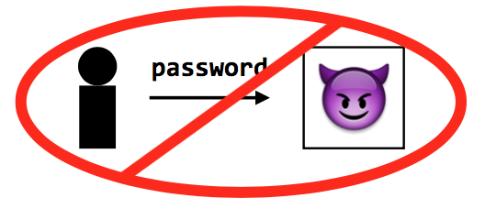
Key Problem of Password
Key problem: once you send a password to the server, it can impersonate you
Solved part of the problem by hashing the password database
But still sending the password to the server to verify on login

Slide 25
Tech 1: challenge-response scheme
Challenge-response
Server chooses a random value R, sends it to client
Client computes H(R + password) and sends to server
Server checks if this matches its computation of hash with expected password
If the server didn't already know password, still doesn't know

Slide 26
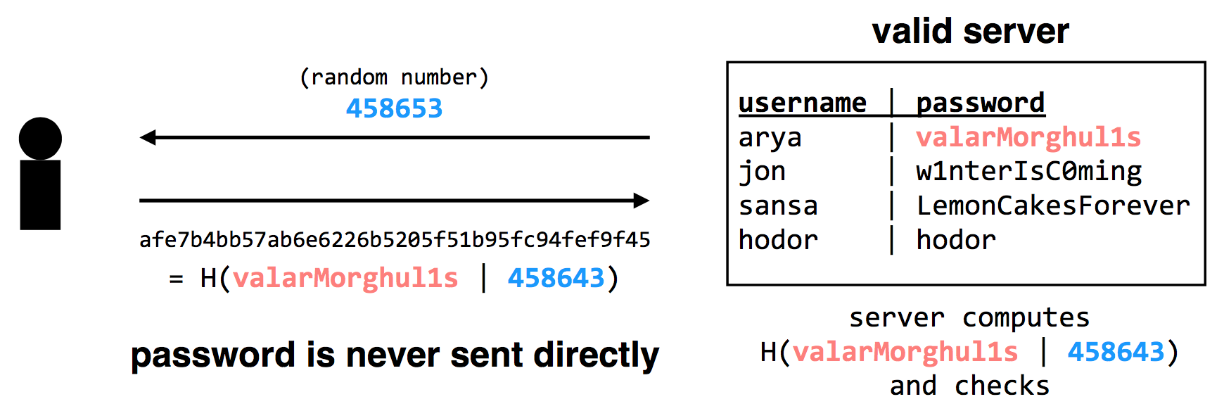
Tech 1: challenge-response scheme
Adversary only learns H(valarMorghul1s | 458643); can not recover the password from that

Slide 27
Tech 2: use passwords to authenticate the server
Make the server prove it knows your password
Client chooses Q, sends to server, server computes H(Q + password), replies
Only the authentic server would know your password!
Unfortunately, not many systems use this in practice
In part because app developers just care about app authenticating user...
Notes:
Slight problem: simple challenge-response can't be used with hashed passwords.
Need the original password to compute hash together with random challenge.
If we store the hashed password, its hash now becomes the effective password..
There's a protocol that allows both.
Store a "hash" of password, challenge-response auth.
Look up "SRP" if building a real system (details too complicated for 6.033).

Slide 28
Tech 2: use passwords to authenticate the server
Complication: could be used with first scheme to fool server!
First, try to log into the server: get the server's challenge R
Then, decide you want to test the server: send it the same R
Send server's reply back to it as response to the original challenge
Principle: be explicit, again!
E.g., hash the intended recipient of response (e.g., client or server), and have the recipient verify it
Notes:
Slight problem: simple challenge-response can't be used with hashed passwords.
Need the original password to compute hash together with random challenge.
If we store the hashed password, its hash now becomes the effective password..
There's a protocol that allows both.
Store a "hash" of password, challenge-response auth.
Look up "SRP" if building a real system (details too complicated for 6.033).

Slide 29
Tech 3: turn offline into online attack
Turn phishing attacks from offline into online attacks
If adversary doesn't have the right image, users will know the site is fake
Adversary could talk to real site, fetch image for each user that logs in

Slide 30
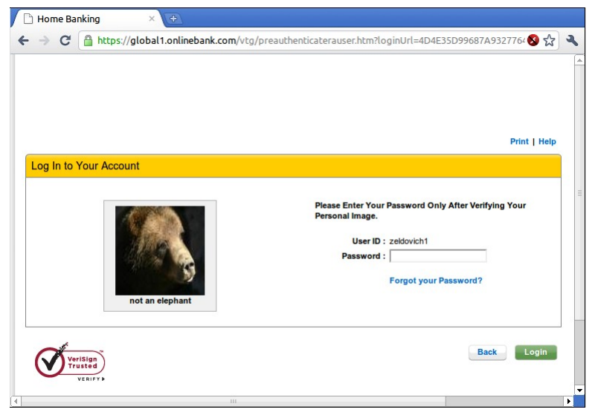
"Sitekey"

Slide 31
Tech 3: turn offline into online attack
Why is it still useful, then?
Requires more efforts on adversary's part to mount attack
Even if adversary does this, bank can detect it
Watch for many requests coming from a single computer
That computer might be trying to impersonate site
Turns an offline/passive attack into an online/active attack
Key insight
Don't need perfect security, small improvements can help

Slide 32
Tech 4: Specific password
Make passwords specific to a site
Instead of sending password, send H(servername + password)
Just like a basic password scheme, from the server's point of view
Except impersonator on another server gets diff passwd
Recommendation
E.g., LastPass

Slide 33
Tech 5: one-time passwords
One-time Password
If adversary intercepts password, can keep using it over and over
Can implement one-time passwords: need to use a different password every time
Design: construct a long chain of hashes.
Start with password and salt, as before
Repeatedly apply hash, n times, to get n passwords
Server stores x = H(H(H(H(...(H(salt+password)))))) = H^{n}(salt+password)
To authenticate, send token=H^{{n-1}}(salt+password)
Server verifies that x = H(token), then sets x <- token
User carries a printout of a few hashes, or uses smartphone to compute them.

Slide 34
Tech 5: one-time passwords
Alternative design: include time in the hash (Google's 2-step verification)
Server and user's smartphone share some secret string K
To authenticate, smartphone computes H(K || current time)
User sends hash value to server, server can check a few recent time values.

Slide 35
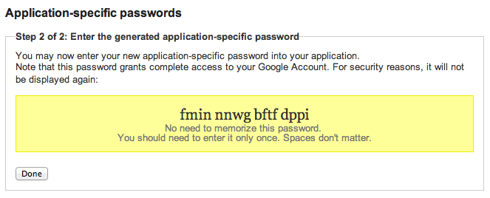
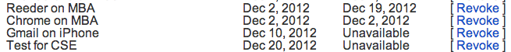
Google's App-specific password

Slide 36
Tech 6: bind authentication and request authorization
One way to look at problem: sending password authorizes any request
Even requests by adversary that intercepts our password
A different design: use password to authenticate any request
req = { username, "write XX to exam.txt", H(password + "write ..") }
Server can check if this is a legitimate req from user using password
Even if adversary intercepts request, cannot steal/misuse password
In practice, don't want to use password, use some session token instead
Could combine well with one-time passwords

Slide 37
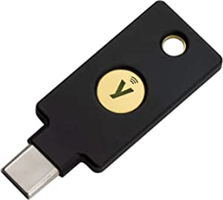
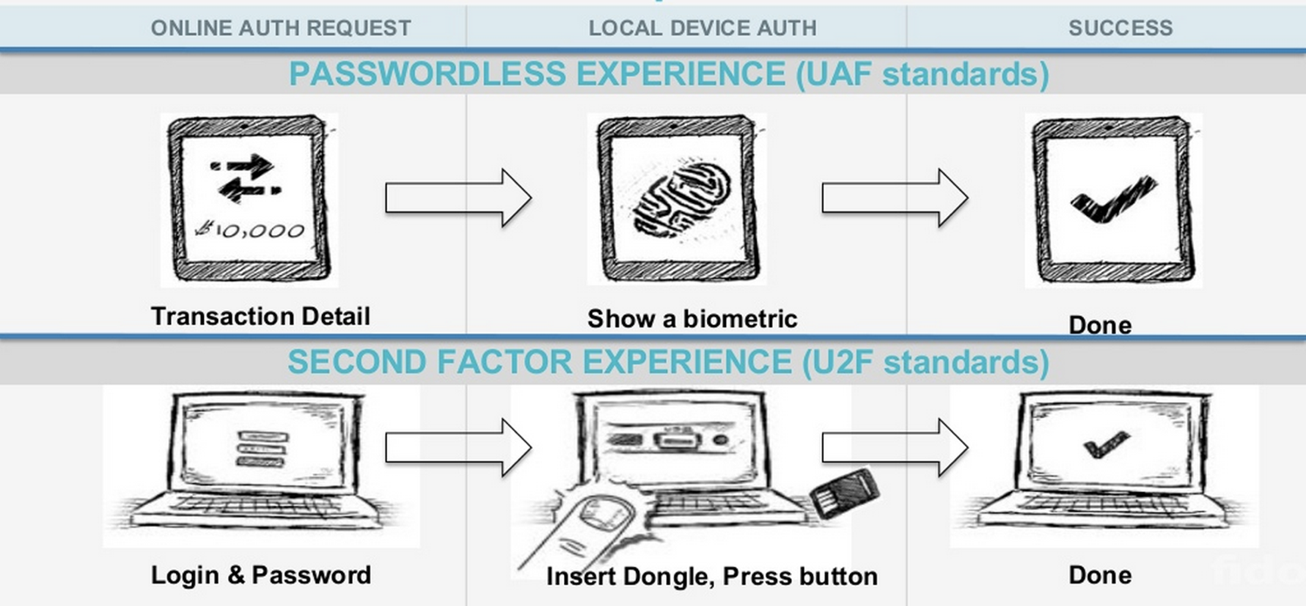
Tech 7: FIDO: Replace the Password

Slide 38
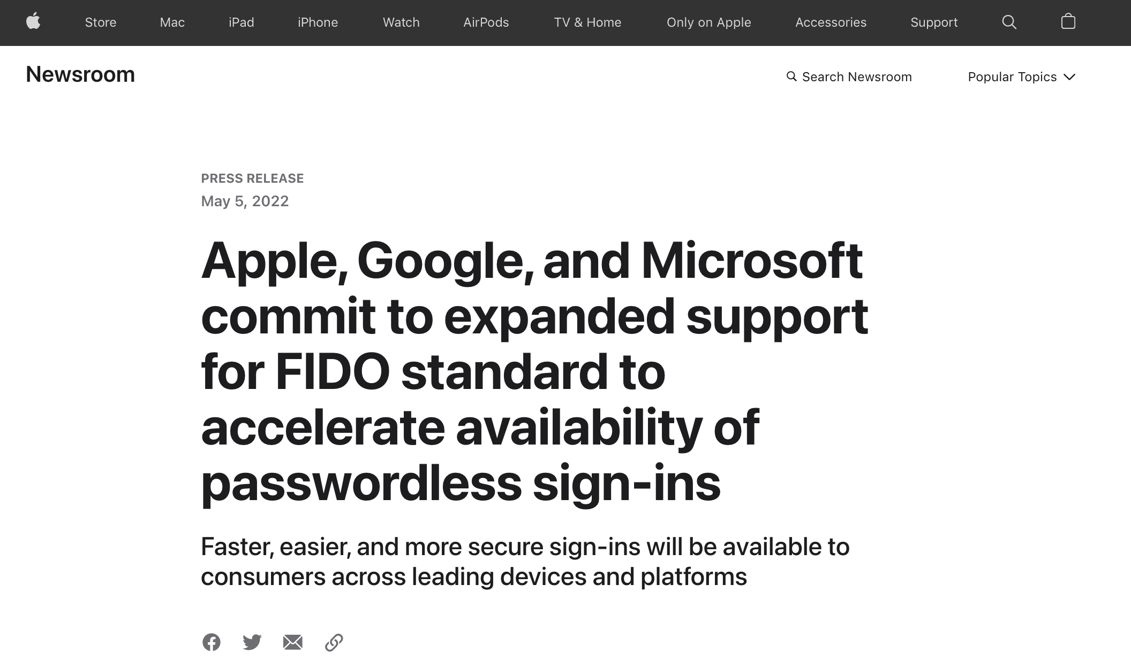

Slide 39
Three Bindings
Fingerprint
User ID
Private key
Publish key
Phone
Server
Secure by hardware (e.g., Enclave)
Secure by isolation

Slide 40
Bootstrapping
How to initially set a password for an account?
If adversary can subvert this process, cannot rely on much else
MIT: admissions office vets each student, hands out account codes
Many web sites: anyone with an email can create a new account
Changing password (e.g., after compromise)
Need some additional mechanism to differentiate user vs. attacker
MIT: walk over to accounts office, show ID, admin can reset password
Many sites: additional "security" questions used to reset password
Password bootstrap / reset mechanisms are part of the security system
Can sometimes be weaker than the password mechanisms
Sarah Palin's Yahoo account was compromised by guessing security Q's
Personal information can be easy to find online

Slide 41
Security Principles

Slide 42
Principle of Least Privilege
Deal with bugs / incomplete mediation
Any component that can arbitrarily access a resource must invoke the guard
If component has a bug or design mistake, can lead to incomplete mediation
General plan: reduce the number of components that must invoke the guard
E.g., arrange for DB server to check permissions on records returned, then security does not depend as much on lookup.cgi

Slide 43
Least Trust
Privileged components are "trusted"
Trusted is “bad”: you are in trouble if a trusted component breaks
Untrusted components are “good”: does not matter if they break
Good design has few trusted components, other things do not affect security

Slide 44
Users Make Mistakes
Social engineering, phishing attacks
How many of you really read the permission acquired by apps during installing?
Good idea: threat model should not assume users are perfect

Slide 45
Cost of Security
Security VS. Availability
E.g., system requires frequent password changes -> users may write them down
How far should a teacher go to protect the exam file?
Put the file on a separate computer, to avoid sharing a file system?
Disconnect computer from the network, to avoid remotely exploitable OS bugs?
Put the server into a separate machine room?
Get a guard to physically protect the machine room?
...
Good idea: cost of security mechanism should be commensurate with value
Notes:
Most security goals/policies not infinitely valuable, can tolerate attacks.
Security mechanisms can be expensive (e.g., wasted user time).

Slide 47

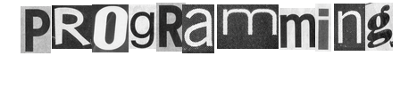

Slide 48
Review: Stack Buffer Overflow
A Typical Buffer Overflow Attack
Inject malicious code in buffer
E.g., shellcode
Overwrite return address to buffer
Once return, the malicious code runs
0101011010111010111010
return addr
ebp
saved ebp
01101101010101010101011010101010101011101010
void function(char *str) {
char buf[16];
strcpy(buf,str);
}
buf

Slide 49
Shellcode Sample to Open "/bin/sh" (21 bytes)
int main(){
char sc[] = "\x6a\x0b" // push byte 0xb
"\x58" // pop eax (now eax=0xb)
"\x99" // cdq
"\x52" // push edx (now edx=0)
"\x68\x2f\x2f\x73\x68" // push dword 0x68732f2f
"\x68\x2f\x62\x69\x6e" // push dword 0x6e69622f
"\x89\xe3" // mov ebx, esp
"\x31\xc9" // xor ecx, ecx (now ecx=0)
"\xcd\x80"; // int 0x80
((void (*)()) sc)();
}
More can be found on https://www.exploit-db.com
Notes:
Convert Double to Quad的缩写，意为将双字数据扩展为四字。 该指令先把edx的每一位置成eax的最高位（若eax>=0x80000000, 则edx=0xFFFFFFFF；若eax<0x80000000，则edx=0x00000000） ，再把edx扩展为eax的高位。
68: h
73: s
2f: /
2f: /
6e: n
69: i
62: b
2f: /

Slide 50
Defense: DEP (Data Execution Prevention)
Execute Code, not Data
Data areas marked non-executable
Stack marked non-executable
Heap marked non-executable
Enforced by hardware
NX: Non-eXecutable (the name on hardware)
You can load your shellcode in the stack or the heap…but you can't jump to it to execute

Slide 51
Attack: Code Reuse (instead of inject) Attack
ROP: Return-oriented Programming
Find code gadgets in existed code base
Usually 1-3 instructions, ends with 'ret'
In libc and application, intended and unintended
Push address of gadgets on the stack
Leverage 'ret' at the end of gadget to connect each code gadgets
No code injection
0101011010
0101011010
0101011010
return addr
0101011010
saved ebp
0101011010
0101011010
0101011010

Slide 52
Code Execution – The ROP Way
Mem[v2] = v1
a₃
v₂
a₂
v₁
Desired Logic
Stack
mov %eax v1;
mov %ebx v2;
mov [%ebx], %eax
a₁: pop eax; ret
a₂: pop ebx; ret
a₃: mov [ebx], eax

Slide 53
Code Execution – The ROP Way
a₃
v₂
a₂
v₁
a₁
…
argv
argc
return addr
caller's ebp
buf (64 bytes)
argv[1]
buf
Mem[v2] = v1
Desired Shellcode
%ebp
a₁: pop eax; ret
a₂: pop ebx; ret
a₃: mov [ebx], eax
Desired store executed!
%esp

Slide 54
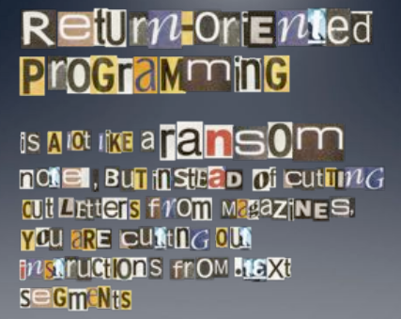

Slide 55
Defense
Hide the binary file
No way to get any gadget
ASLR to randomize the code position
Short for "Address Space Layout Randomization"
Harder to find gadgets
Canary to protect the stack
Try to detect stack overflow (e.g., overflow return address)

Slide 56
ASLR
Change the layout of memory space
Every time when a process is created
Question: how about create by fork?
User-level as well as kernel-level

Slide 57

Canary
Embed "canaries" in stack frames and verify their integrity prior to function return
Canary is just a random number
Check canary before return, alert if not equal
StackGuard implemented as a GCC patch
Program must be recompiled
Performance overhead: 8% for Apache
Stack
Return Addr
Canary

Slide 58
CFI: Control Flow Integrity

Slide 59
CFI: Control-Flow Integrity
Main idea: pre-determine control flow graph (CFG) of an application
Static analysis of source code
Static binary analysis ← CFI
Execution profiling
Explicit specification of security policy
Execution must follow the pre-determined control flow graph

Slide 60
CFI Motivation
Control flow
Anatomy of many software attacks
Notes:
Many software attacks consists in subverting the control-flow of a binary. Often the virus injects code of its own,. Then by a buffer overflow, it hijacks the program counter to execute the desired code, eventually reaching a point at which the system is compromised (e.g., a shell is executed).

Slide 61
CFI Idea
+
=
Executable
Control-Flow Graph
Self-checking program
Notes:
The idea of CFI is very simple: embed a simple security policy within the executable itself, in the form of a control-flow graph. The executable itself will monitor its execution, and any attempt to deviate from the prescribed CFG will result in an error. Thus, if a virus attempts to step outside the prescribed CFG, it will shut down the program.

Slide 62
Branch Types
Direct Branches
Direct call
Direct jump
Indirect Branches
Return
Indirect call
Indirect jump
In Apache and its libraries
Types | In Binary | Run-time
Direct call | 16.8% | 14.5%
Direct jump | 74.3% | 0.8%
Return | 6.3% | 16.3%
Indirect call | 2.1% | 0.2%
Indirect jump | 0.5% | 68.3%
has 1 target: 94.7%
<= 2 targets: 99.3%
>10 targets: 0.1%

Slide 63
CFI: Binary Instrumentation
Use binary rewriting to instrument code with runtime checks
Inserted checks ensure that the execution always stays within the statically determined CFG
Whenever an instruction transfers control, destination must be valid according to the CFG
Goal: Secure even if the attacker has complete control over the thread's address space

Slide 64
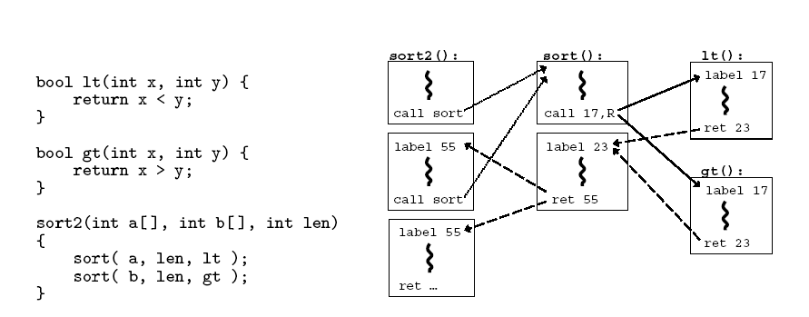
CFG Example

Slide 65
CFI: Control Flow Enforcement
For each control transfer, determine statically its possible destination(s)
Insert a unique bit pattern at every destination
Two destinations are equivalent if CFG contains edges to each from the same source
This is imprecise (why?)
Use same bit pattern for equivalent destinations

Slide 66
CFI: Control Flow Enforcement
Insert binary code that at runtime will check whether the bit pattern of the target instruction matches the pattern of possible destinations

Slide 67
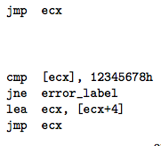
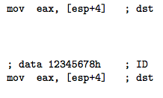
CFI: Example of Instrumentation
Original
Patched

Slide 68
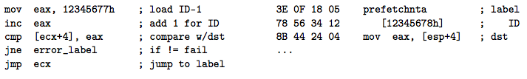
CFI: Example of Instrumentation
Prefetchnta: prefetch memory to cache. Become a nop if not available.

Slide 69
CFI: Preventing Circumvention
Unique IDs
Bit patterns chosen as destination IDs must not appear anywhere else in the code memory except ID checks
Non-writable code
Program should not modify code memory at runtime
What about run-time code generation and self-modification?
Non-executable data
Program should not execute data as if it were code
Enforcement: hardware support + prohibit system calls that change protection state + verification at load-time

Slide 70
Improving CFI Precision
Suppose a call from A goes to C, and a call from B goes to either C, or D (when can this happen?)
CFI will use the same tag for C and D, but this allows an "invalid" call from A to D
Possible solution: duplicate code or inline
Possible solution: multiple tags

Slide 71
Improving CFI Precision
Function F is called first from A, then from B; what's a valid destination for its return?
CFI will use the same tag for both call sites, but this allows F to return to B after being called from A
Solution: shadow call stack
Maintain another stack, just for return address
Intel CET to the rescue (not available yet)

Slide 72
CFI: Security Guarantees
Effective against attacks based on illegitimate control-flow transfer
Stack-based buffer overflow, return-to-libc exploits, pointer subterfuge
Does not protect against attacks that do not violate the program's original CFG
Incorrect arguments to system calls
Substitution of file names
Other data-only attacks

Slide 73
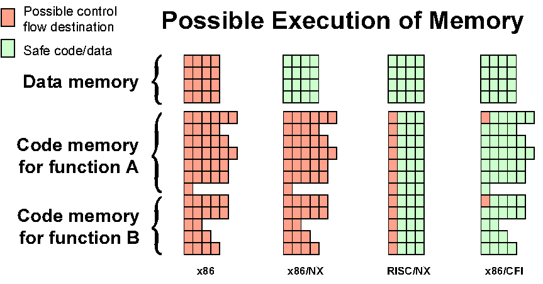
Possible Execution of Memory
[Erlingsson]

Slide 74
Blind ROP

Slide 75
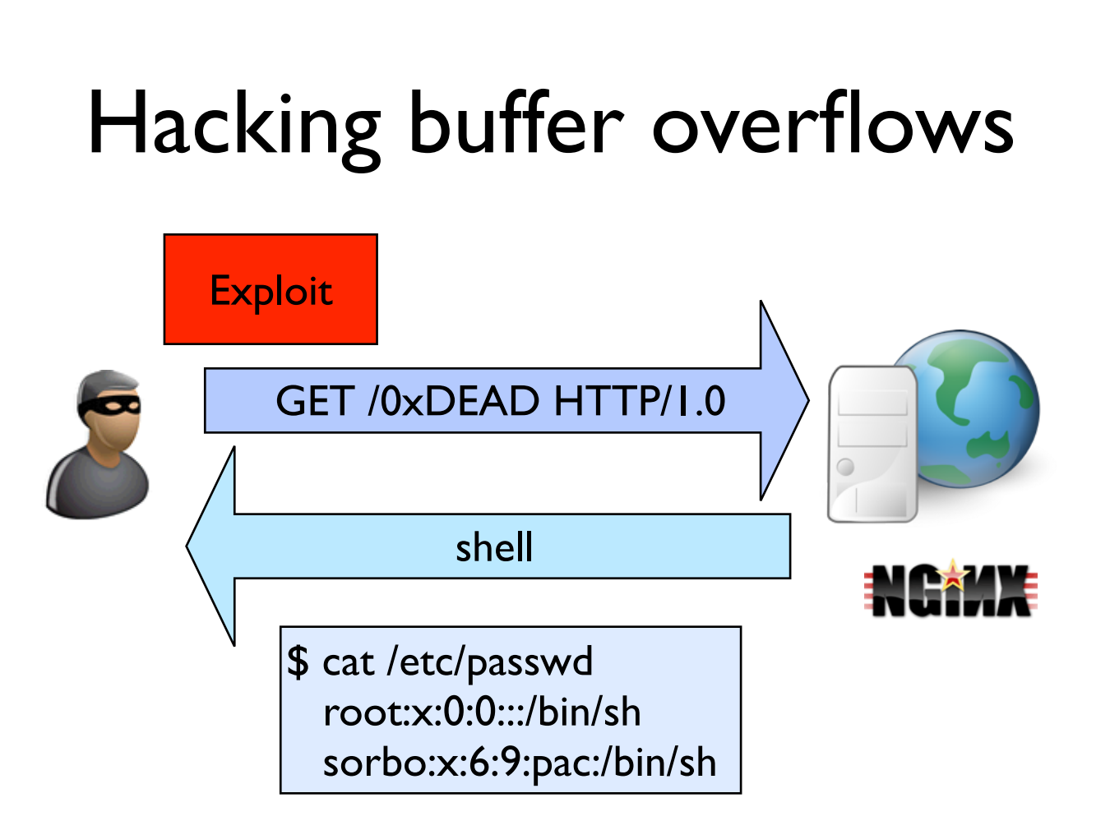

Slide 76
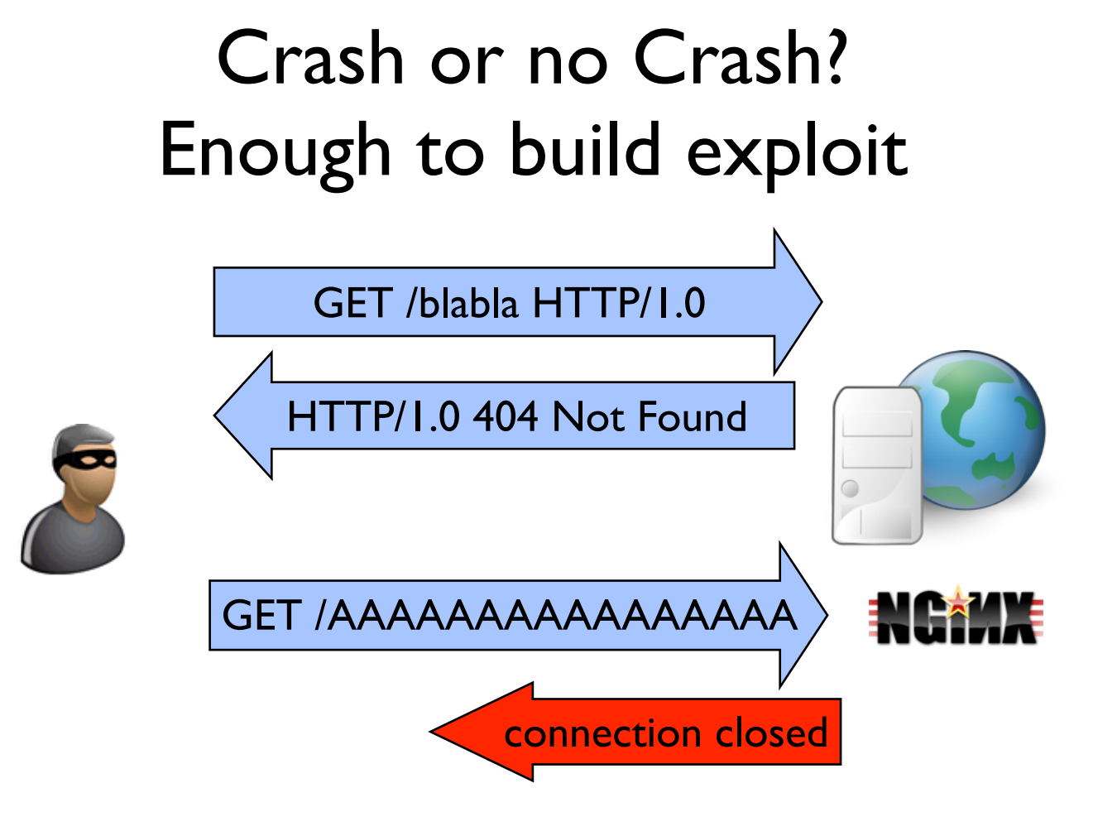

Slide 77
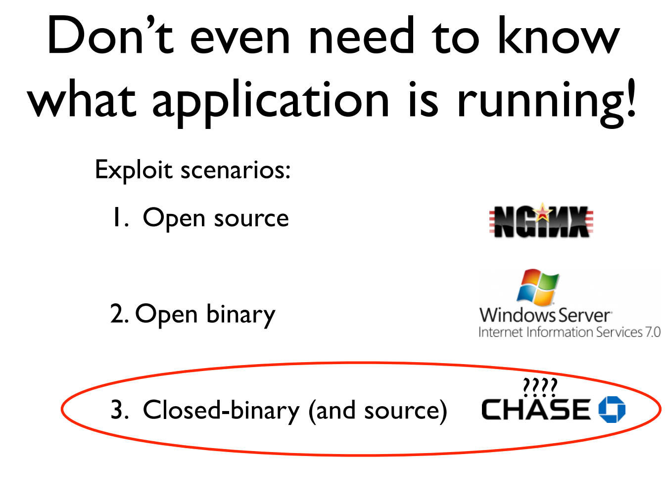

Slide 78
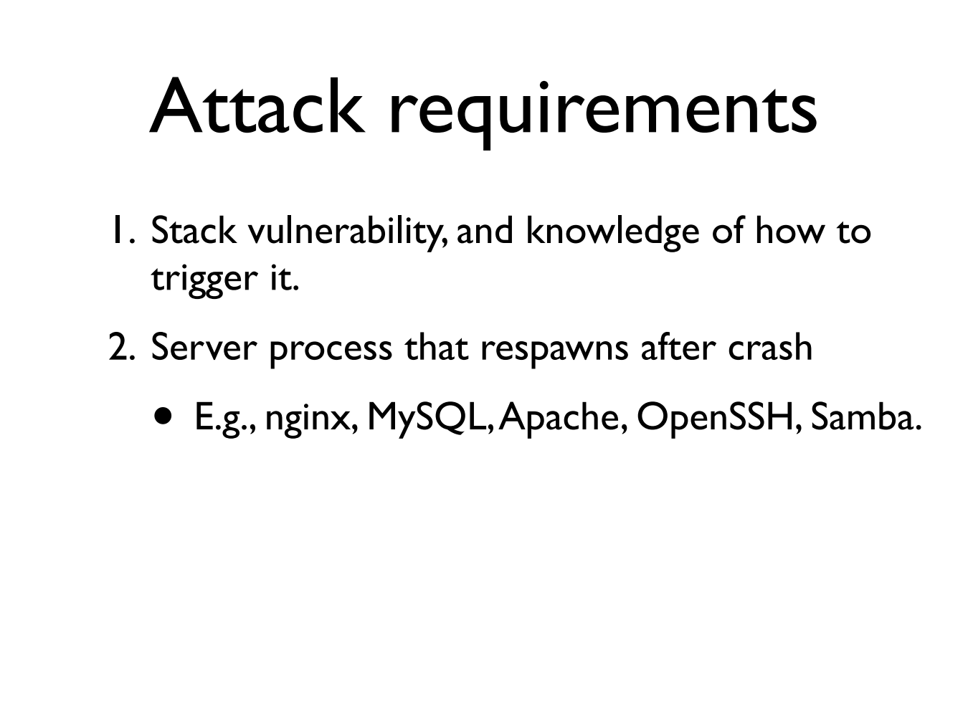

Slide 79
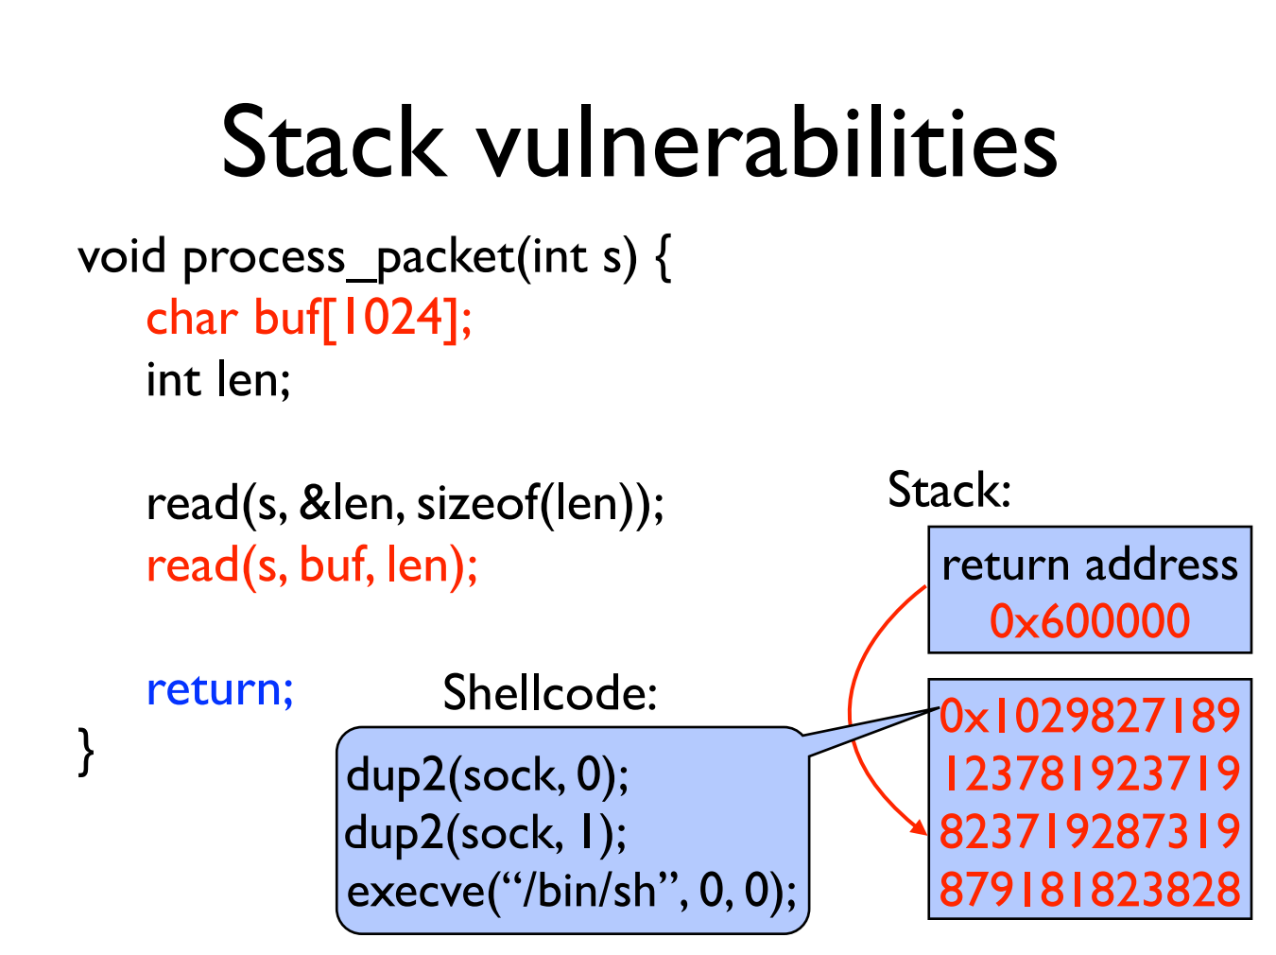

Slide 80
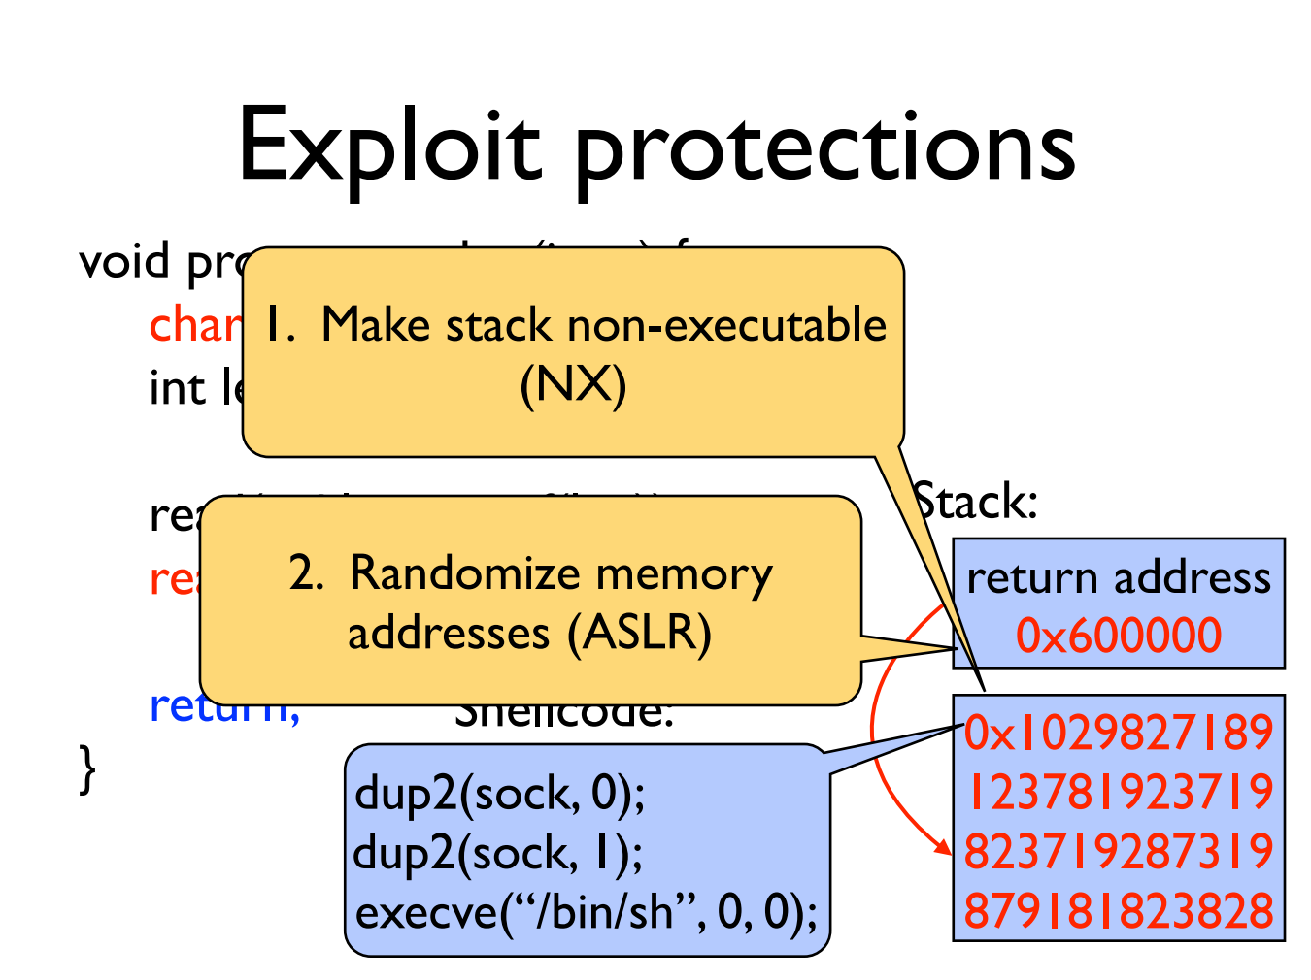

Slide 81
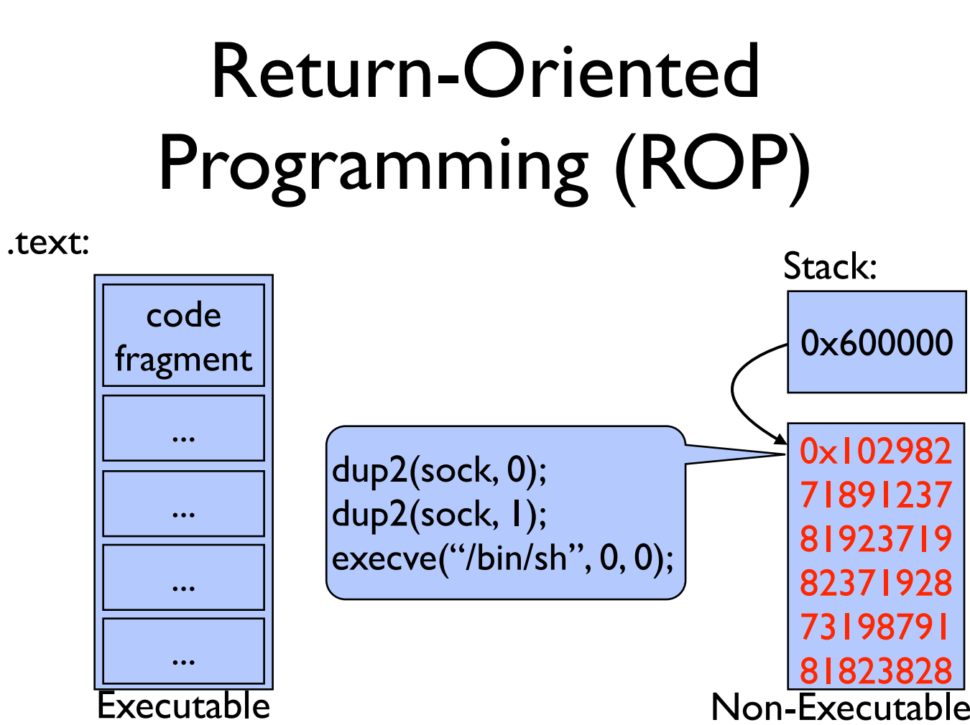

Slide 82
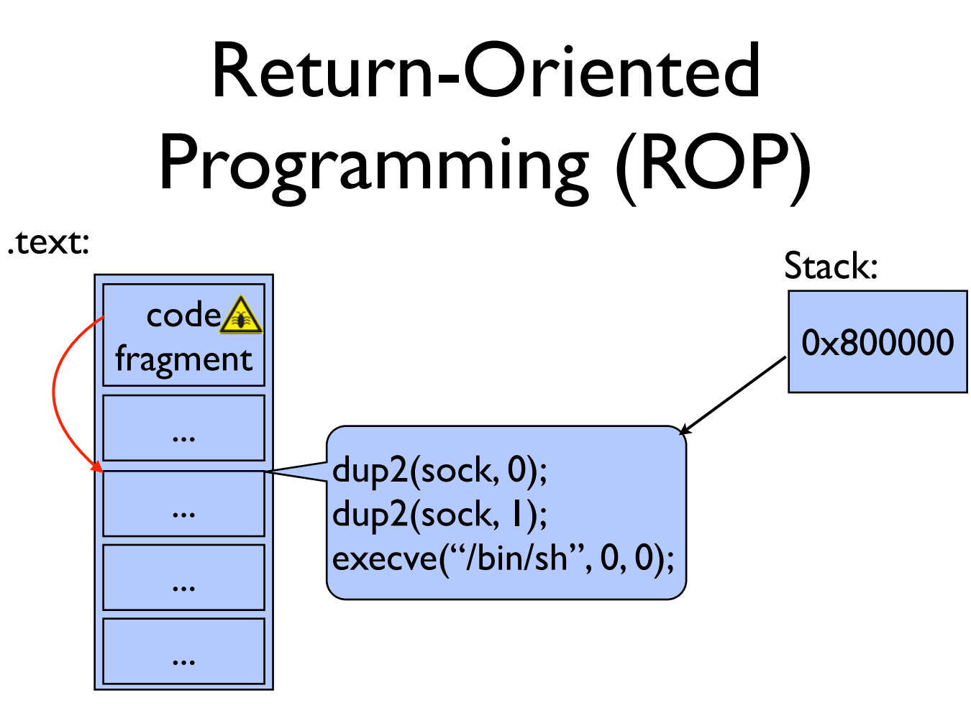

Slide 83
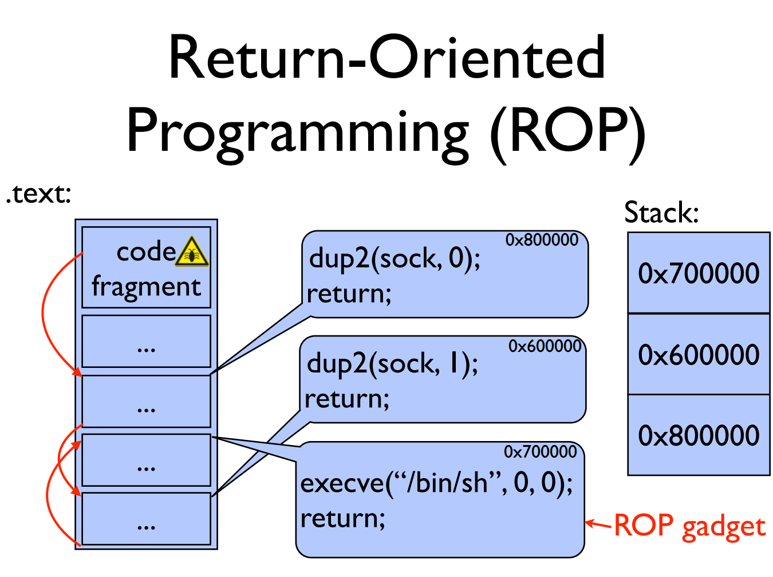

Slide 84
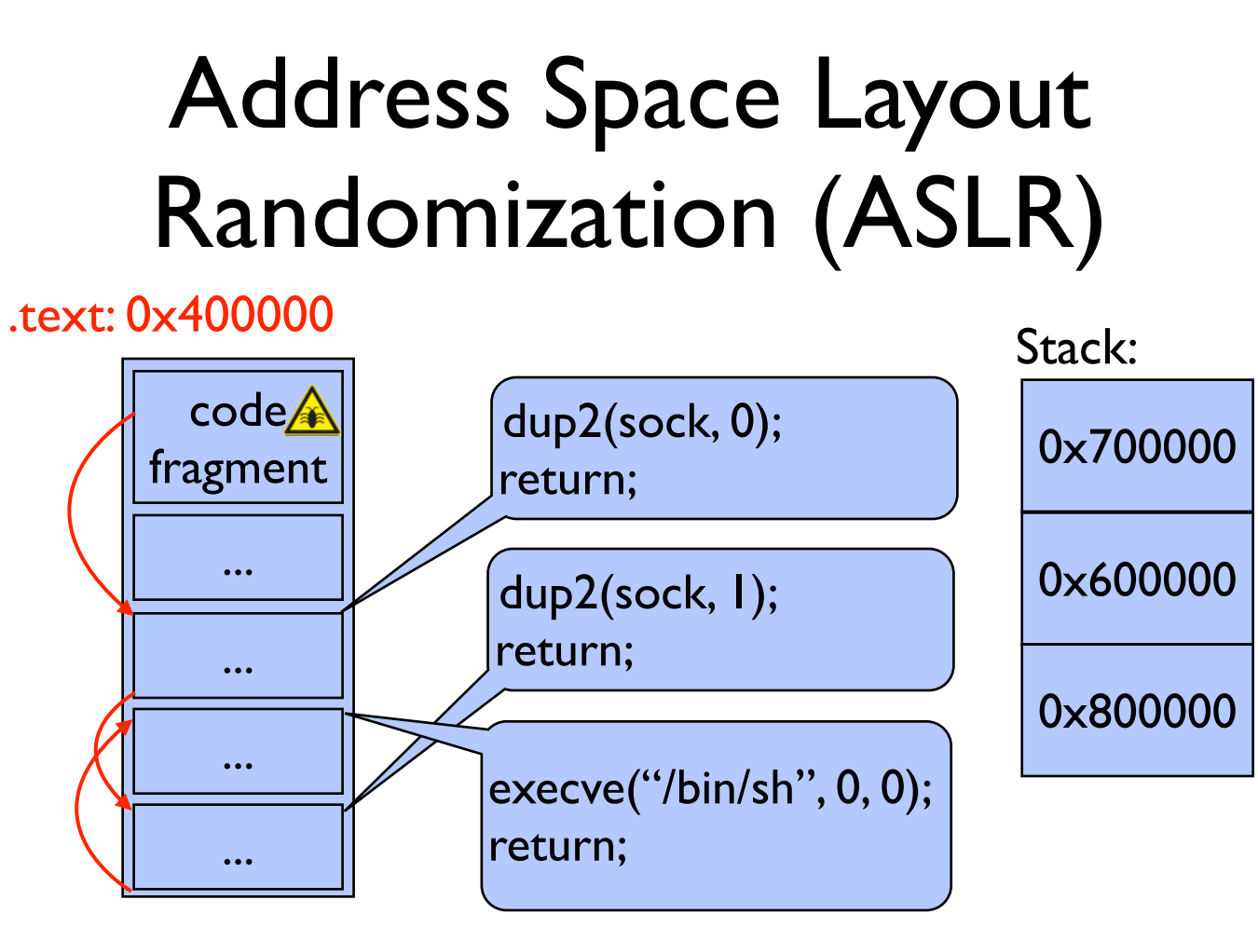

Slide 85
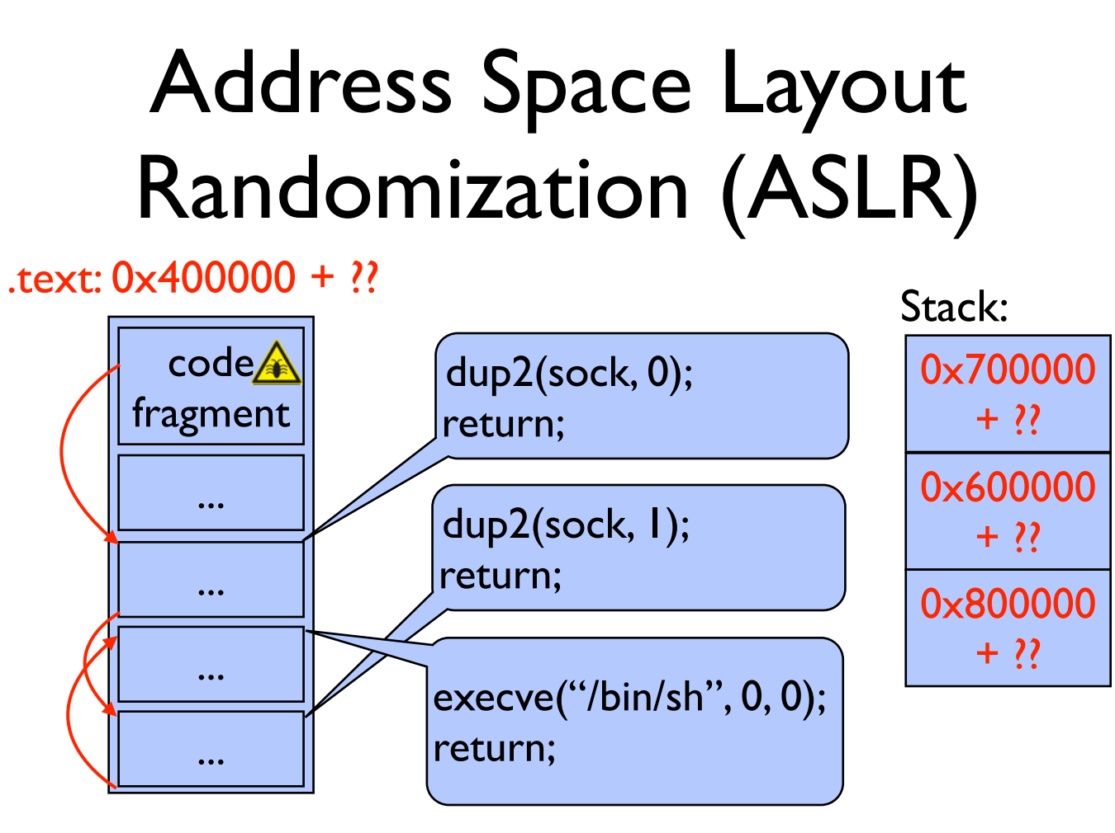

Slide 86
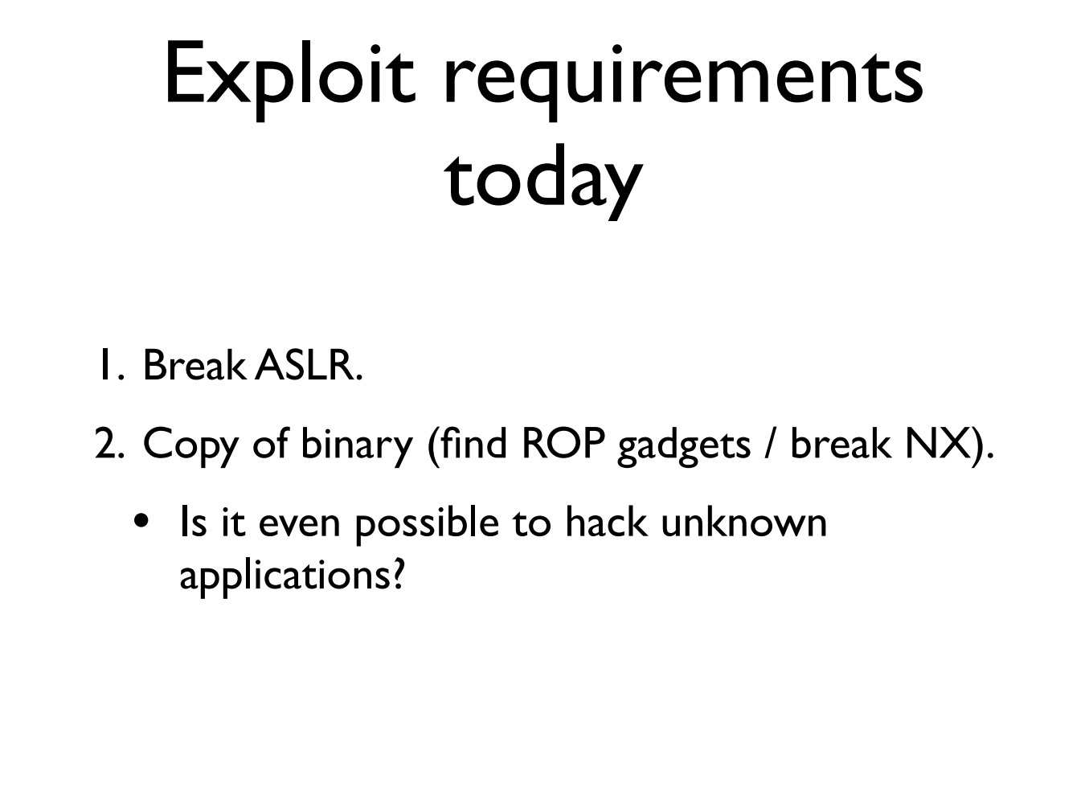

Slide 87
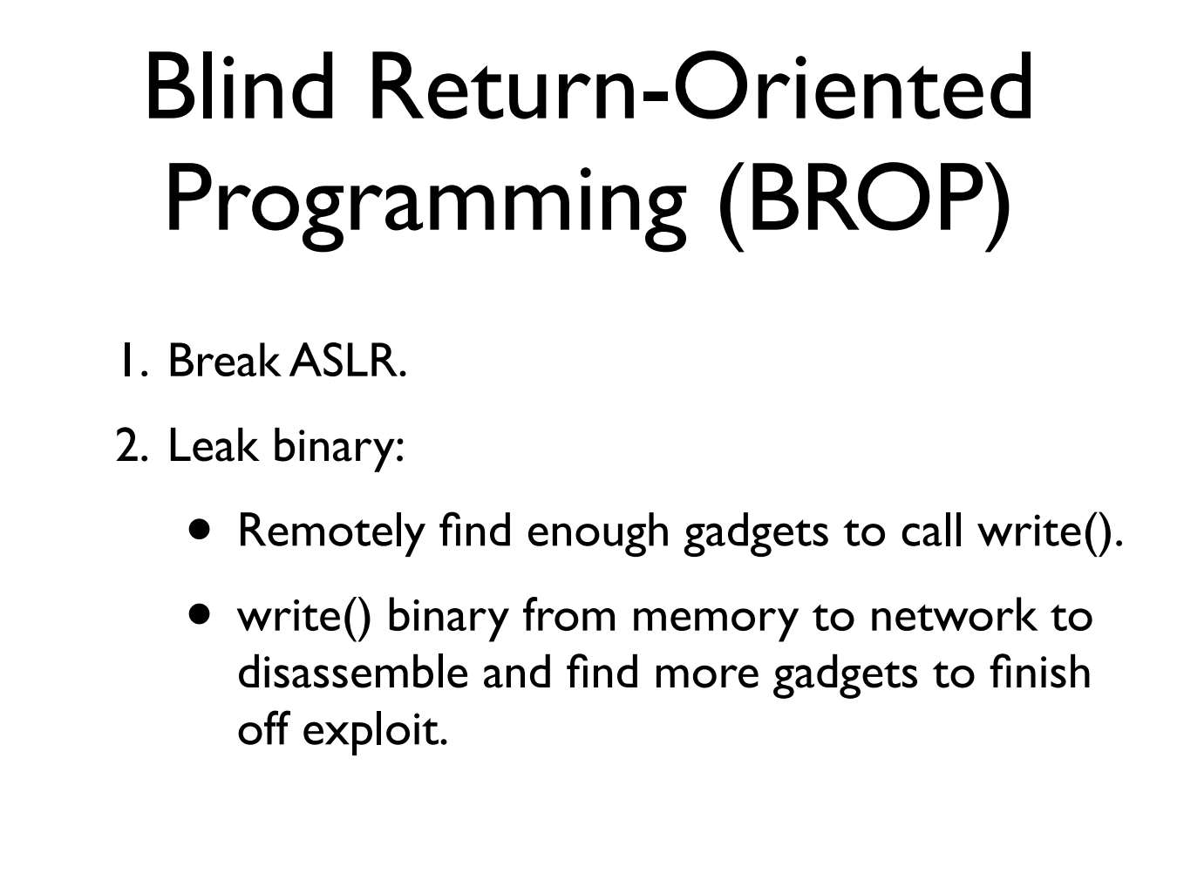

Slide 88
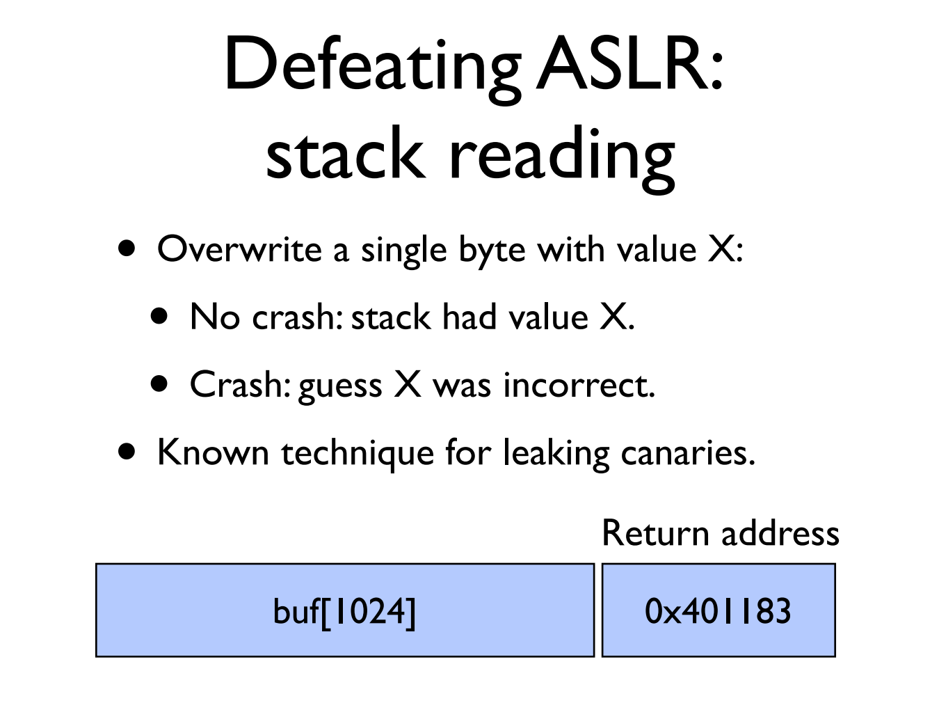

Slide 89
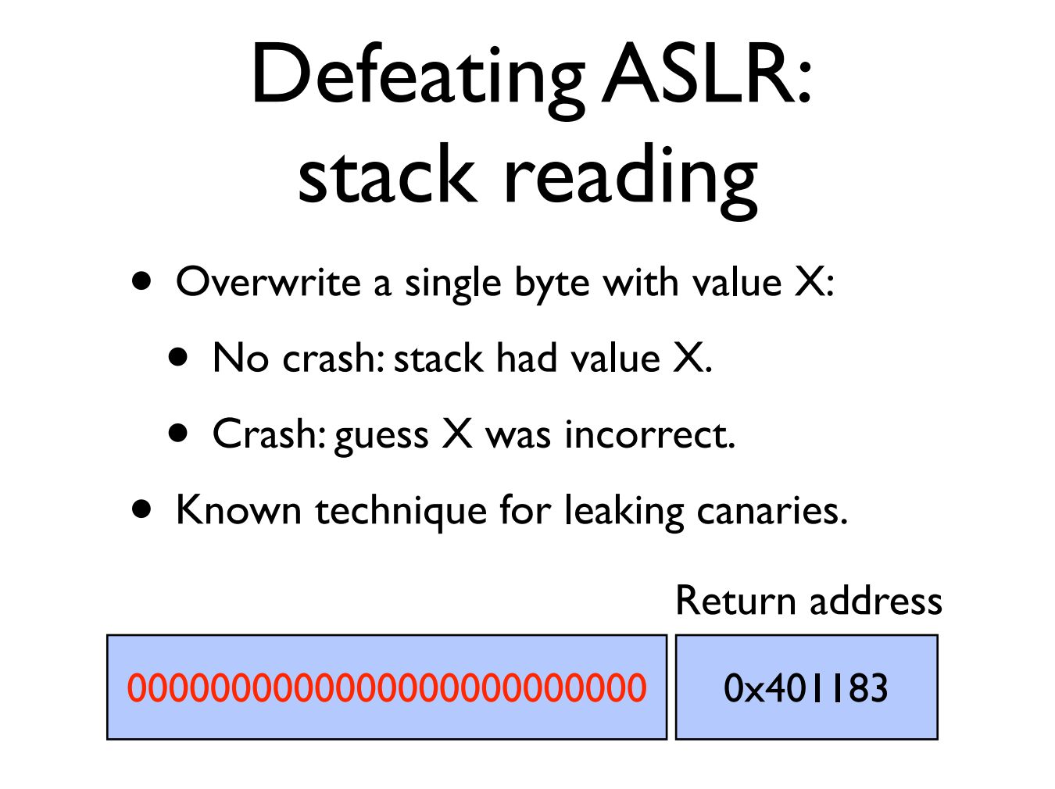

Slide 90
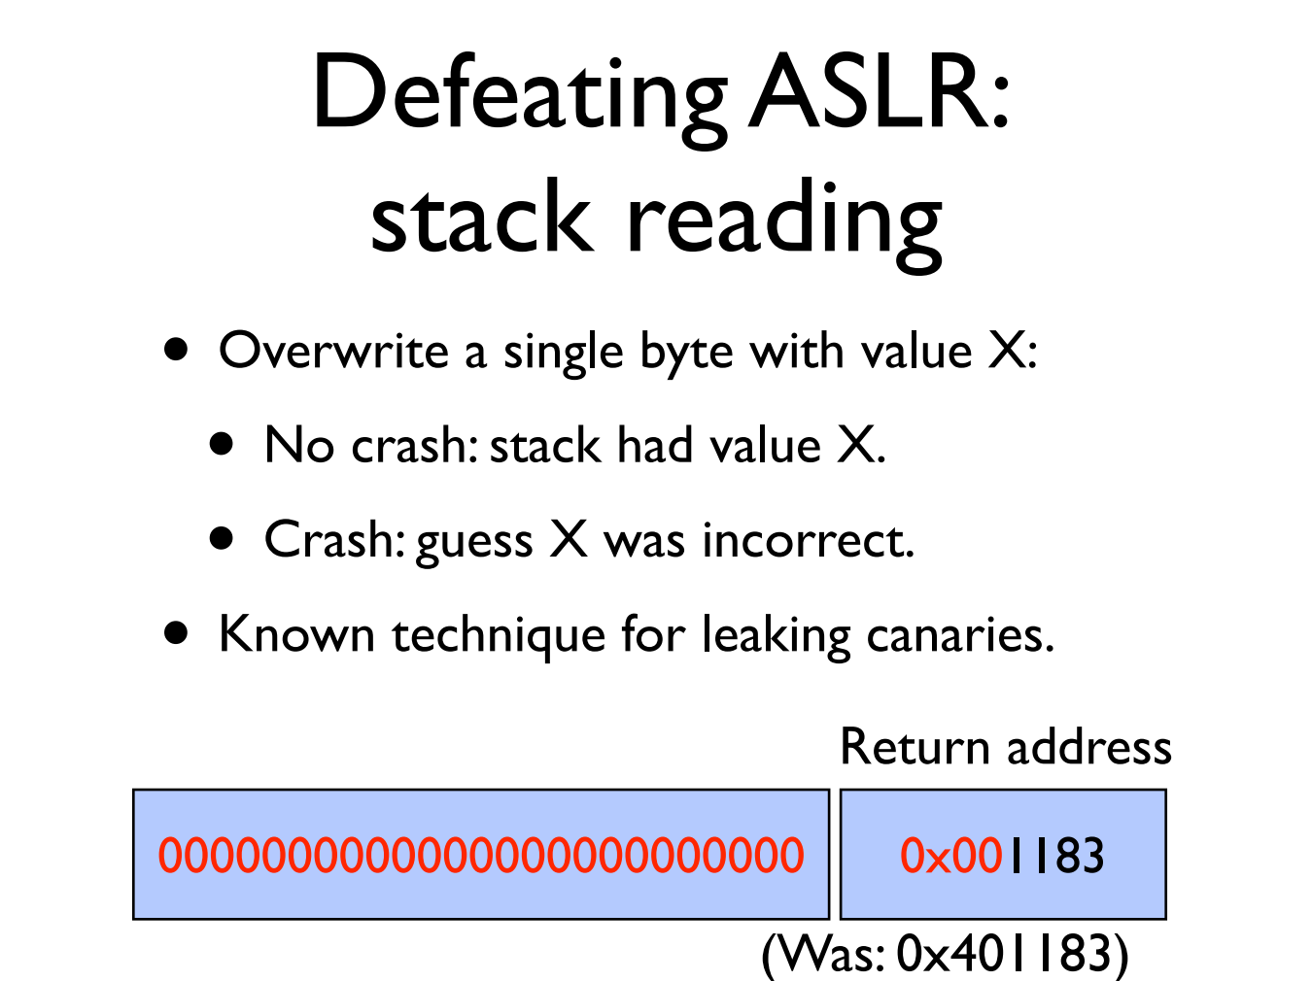

Slide 91


Slide 92


Slide 93
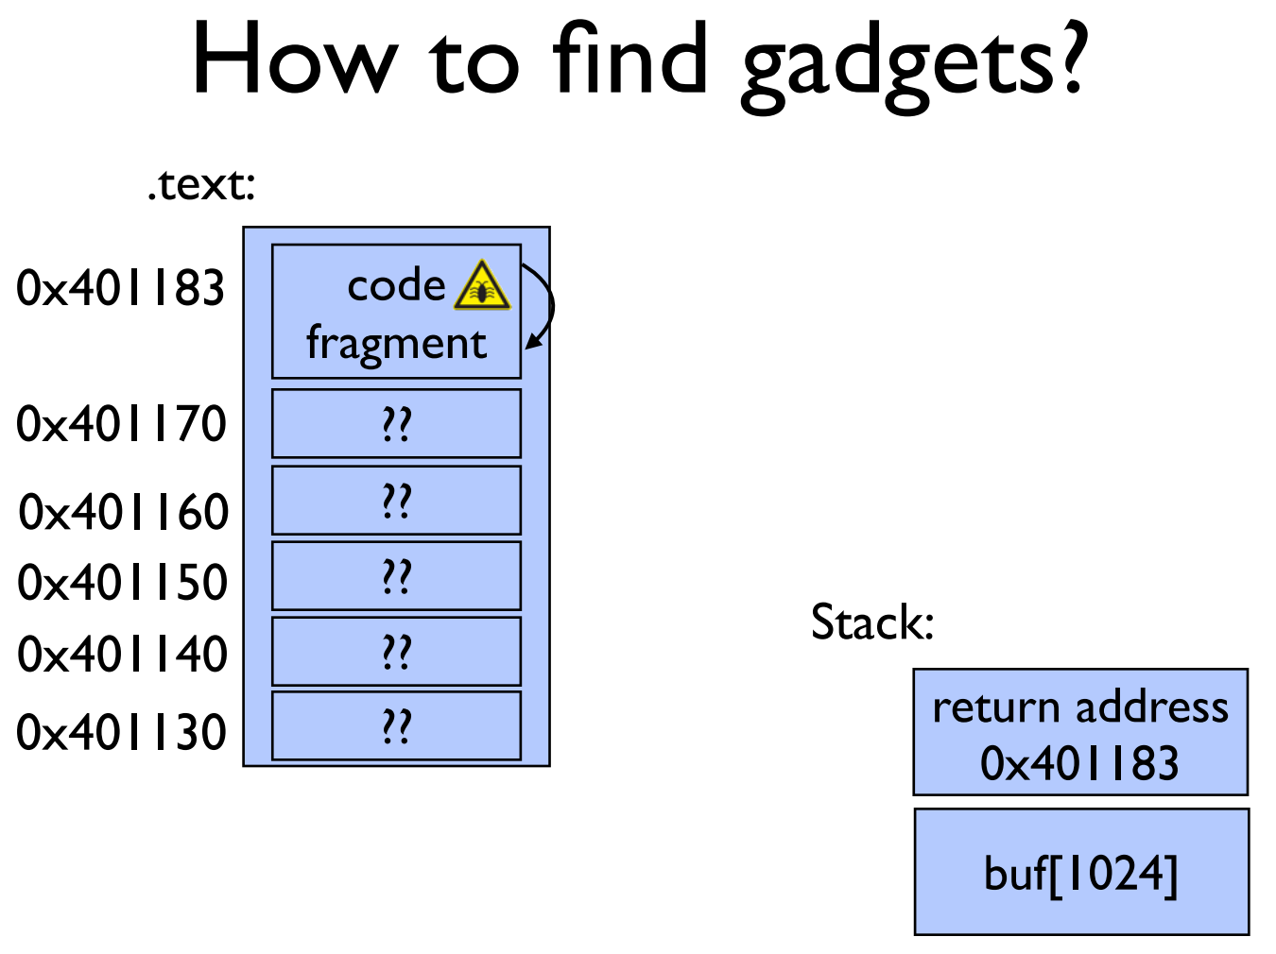

Slide 94
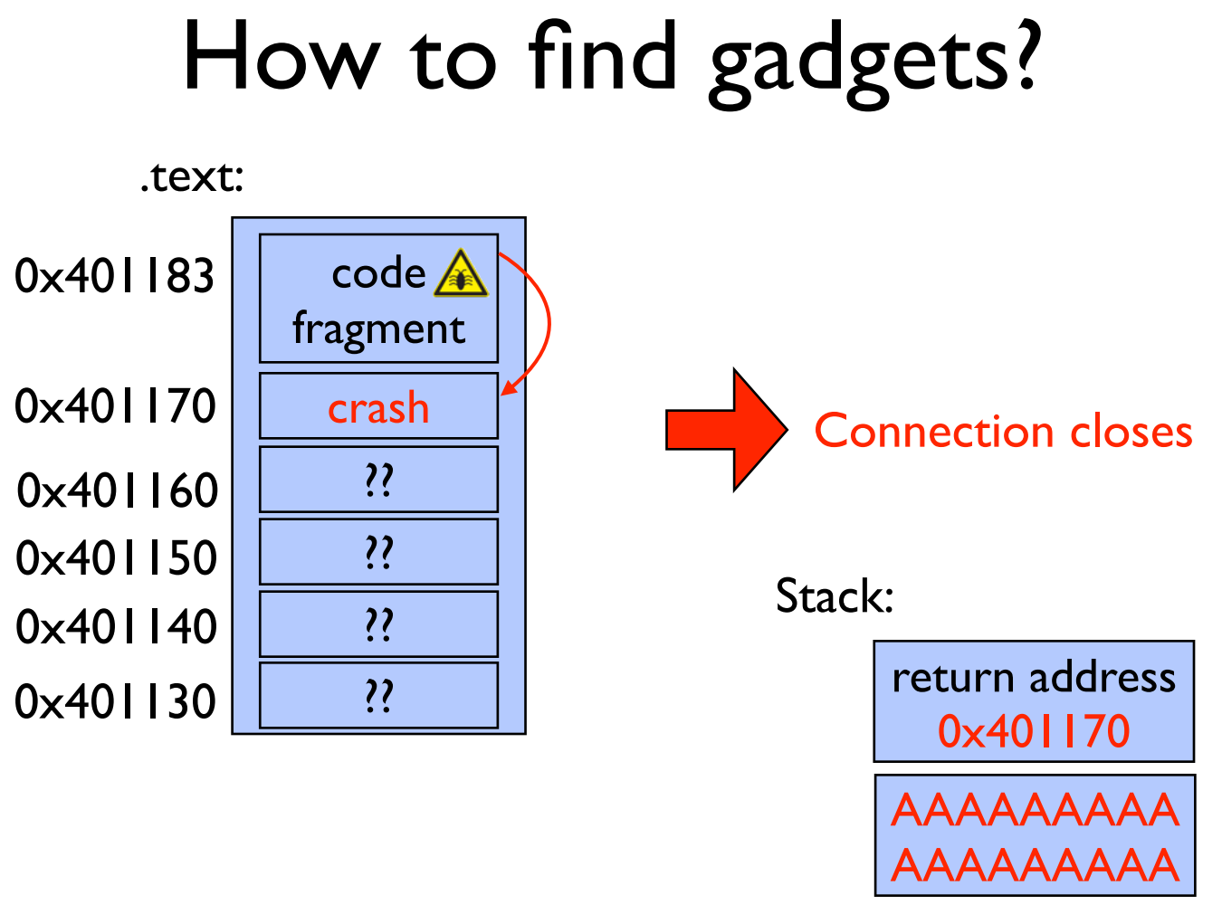

Slide 95


Slide 96
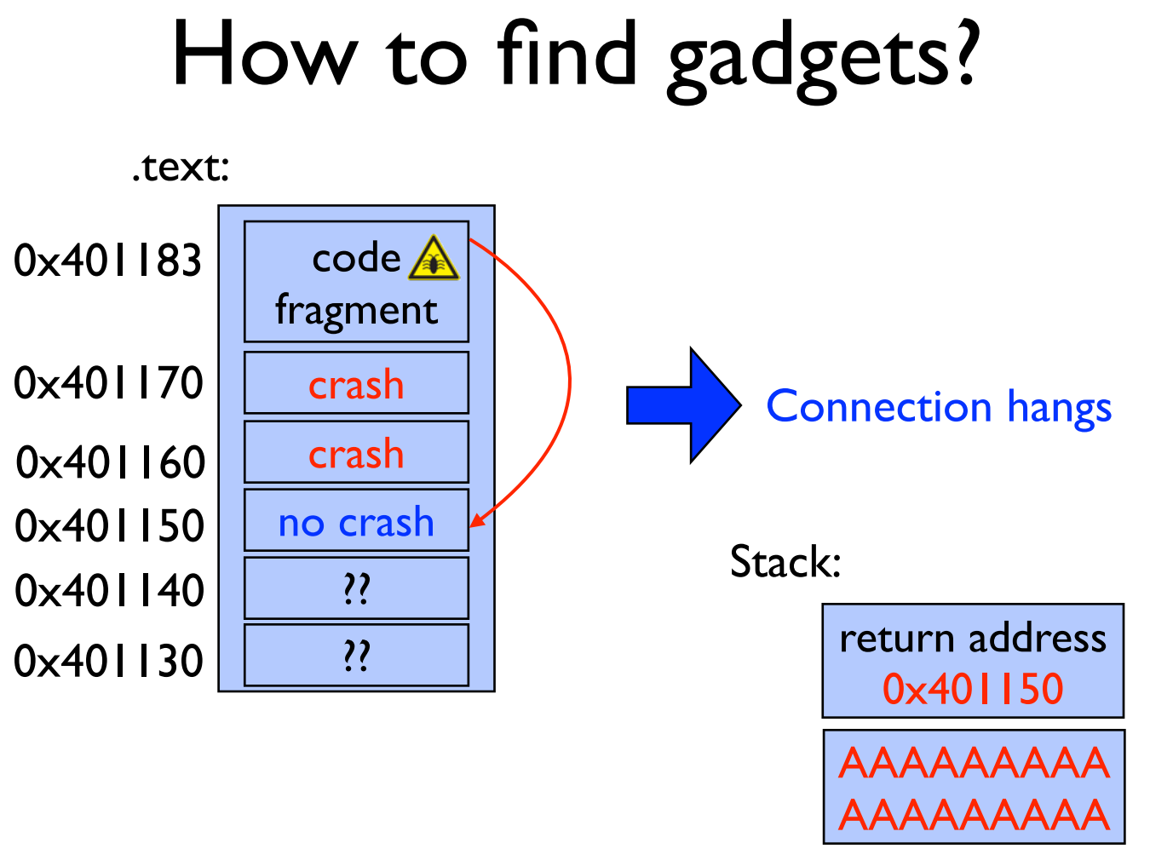

Slide 97
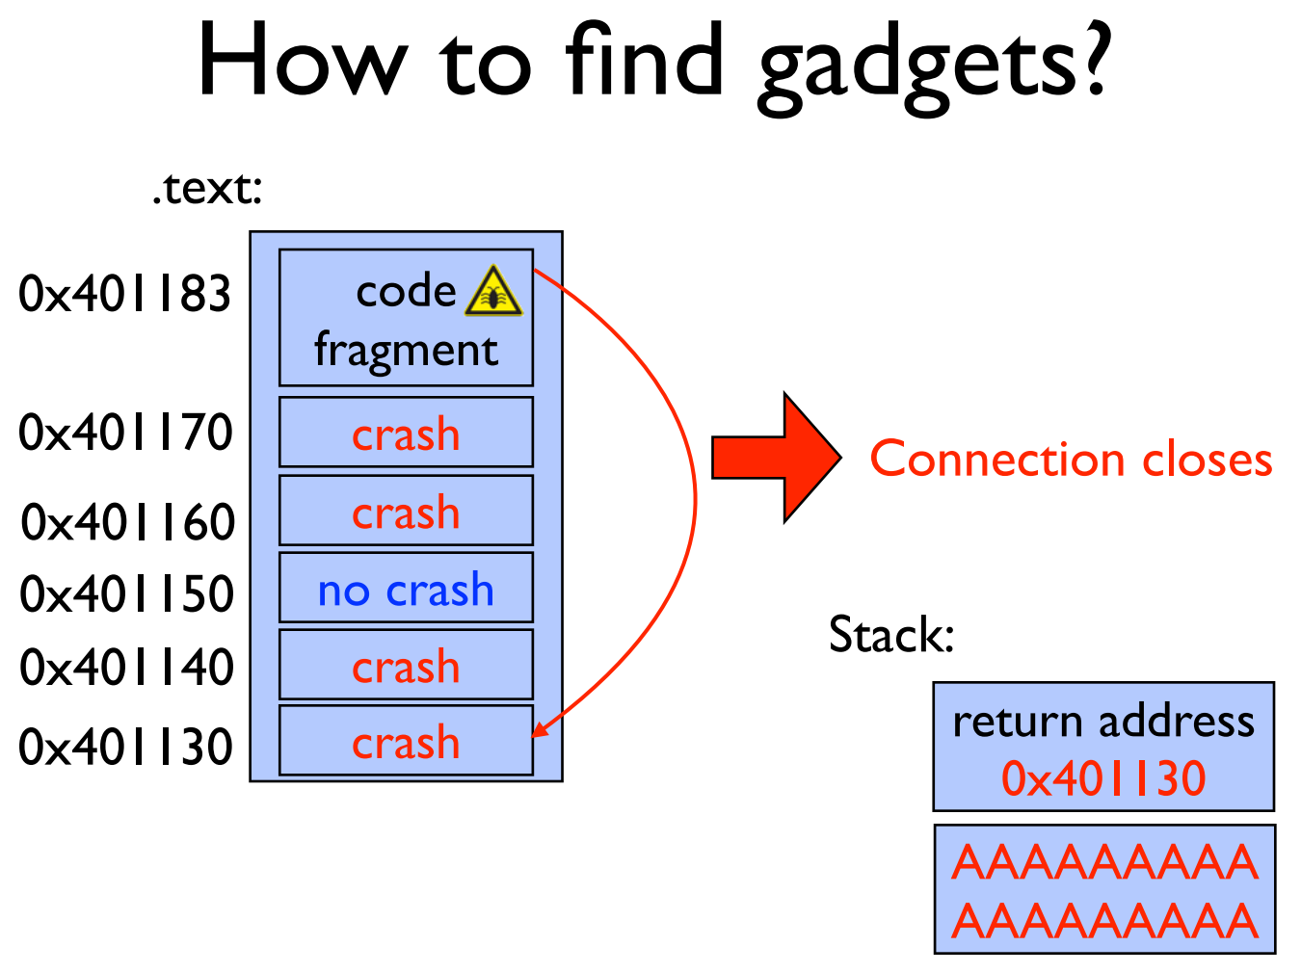

Slide 98
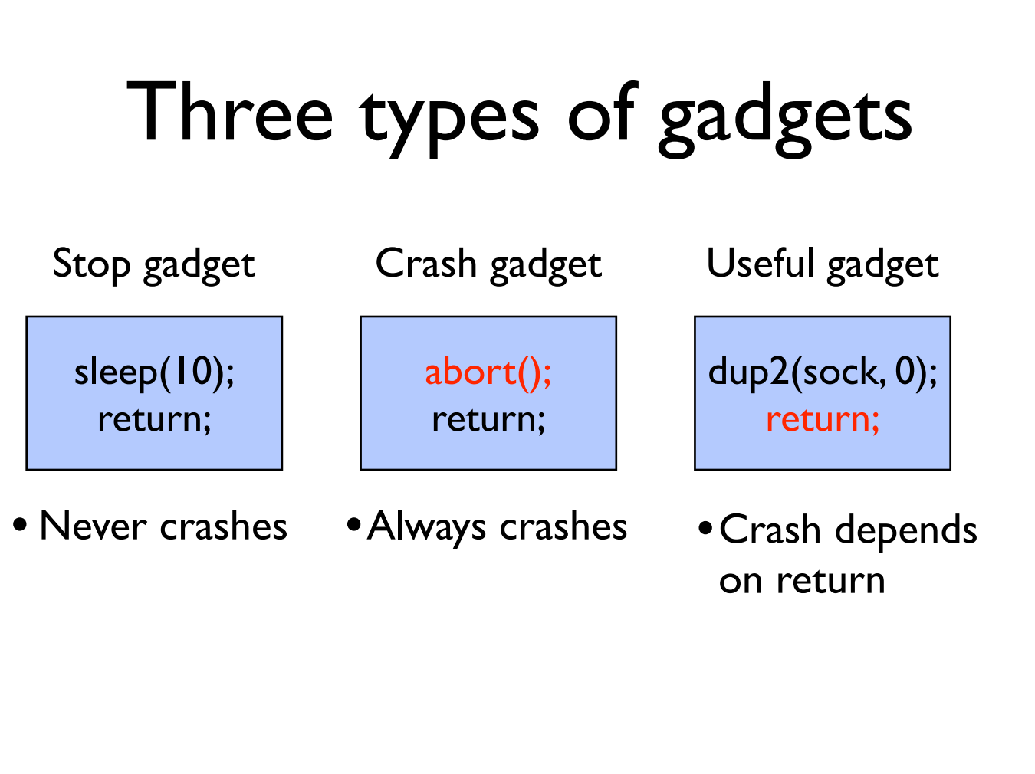

Slide 99
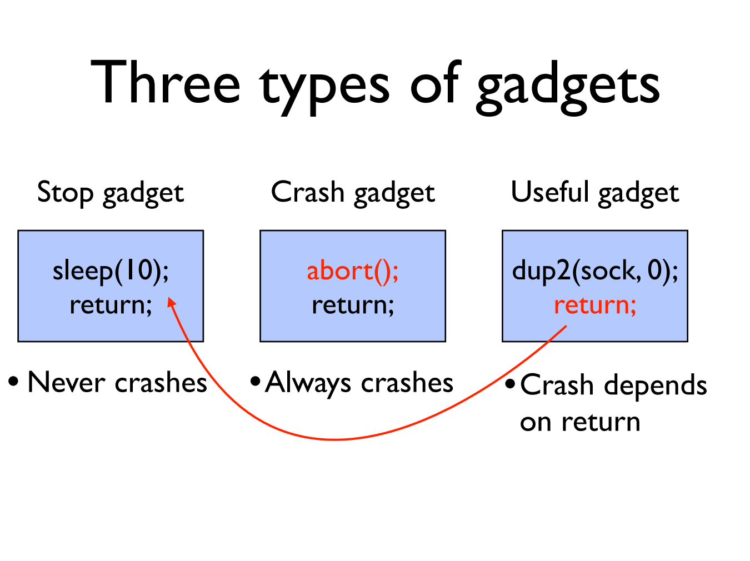

Slide 100
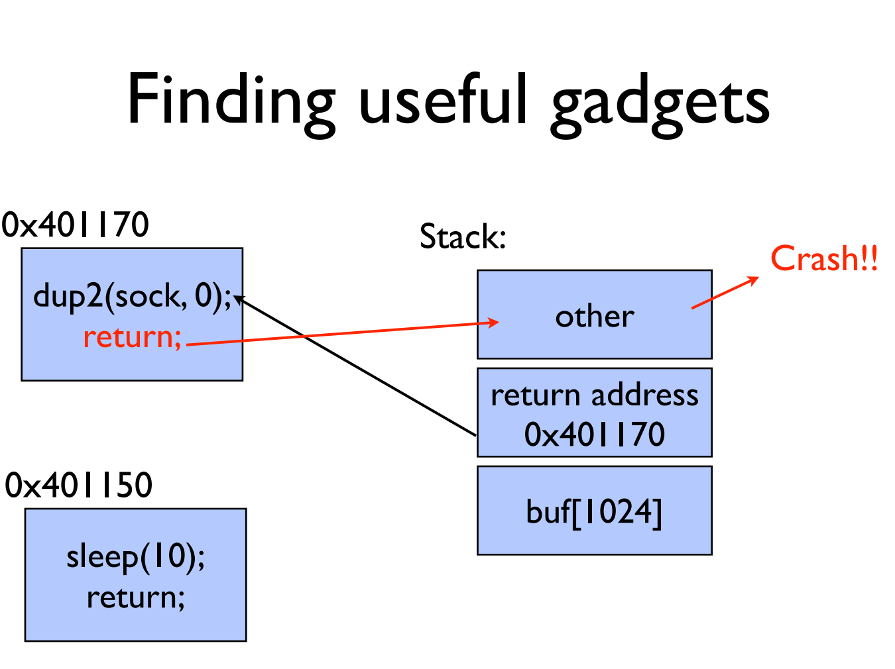

Slide 101
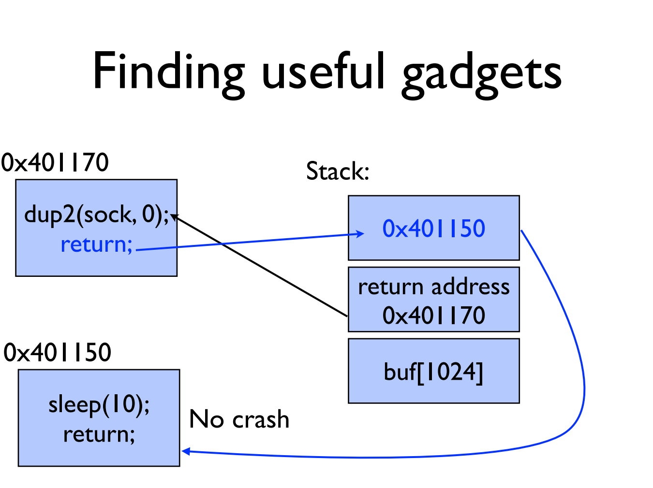

Slide 102
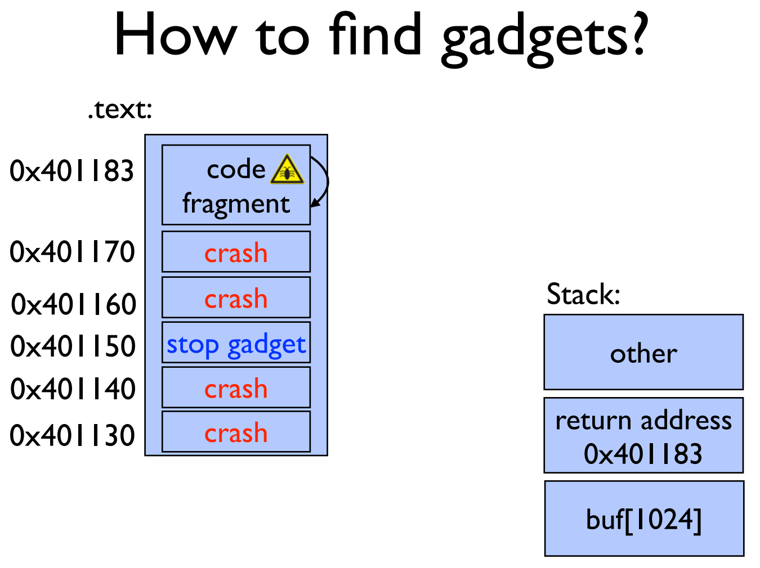

Slide 103
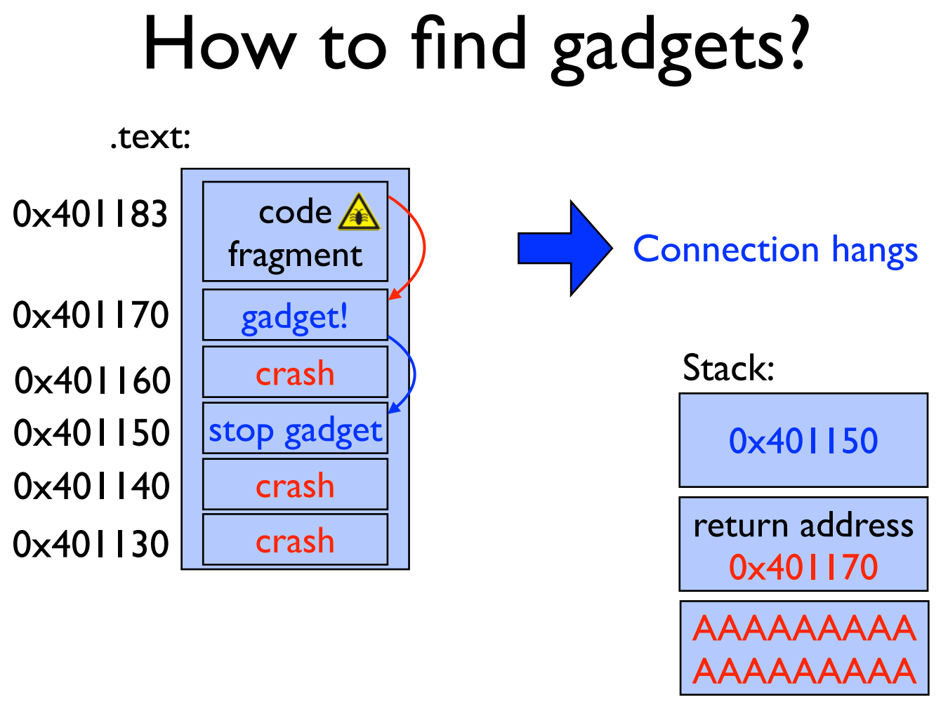

Slide 104
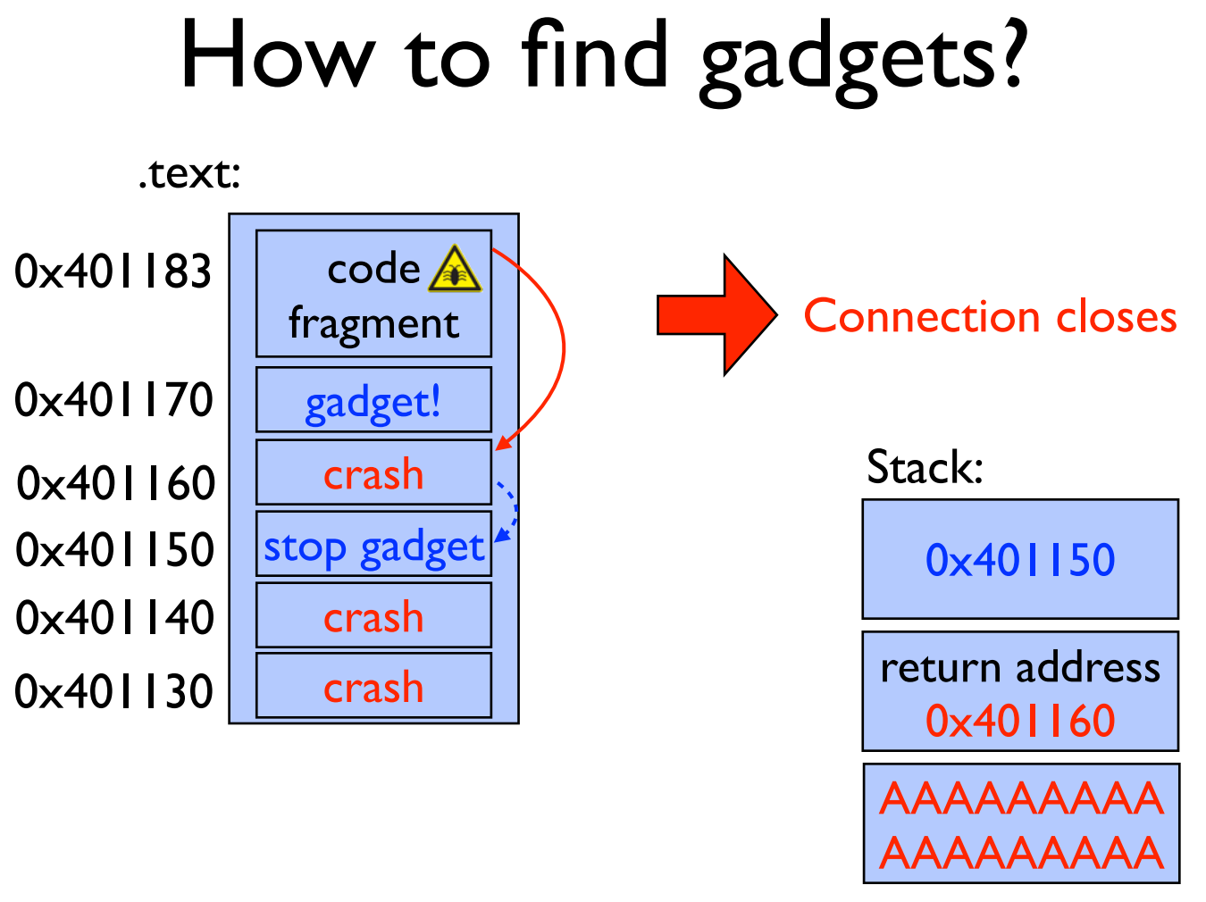

Slide 105
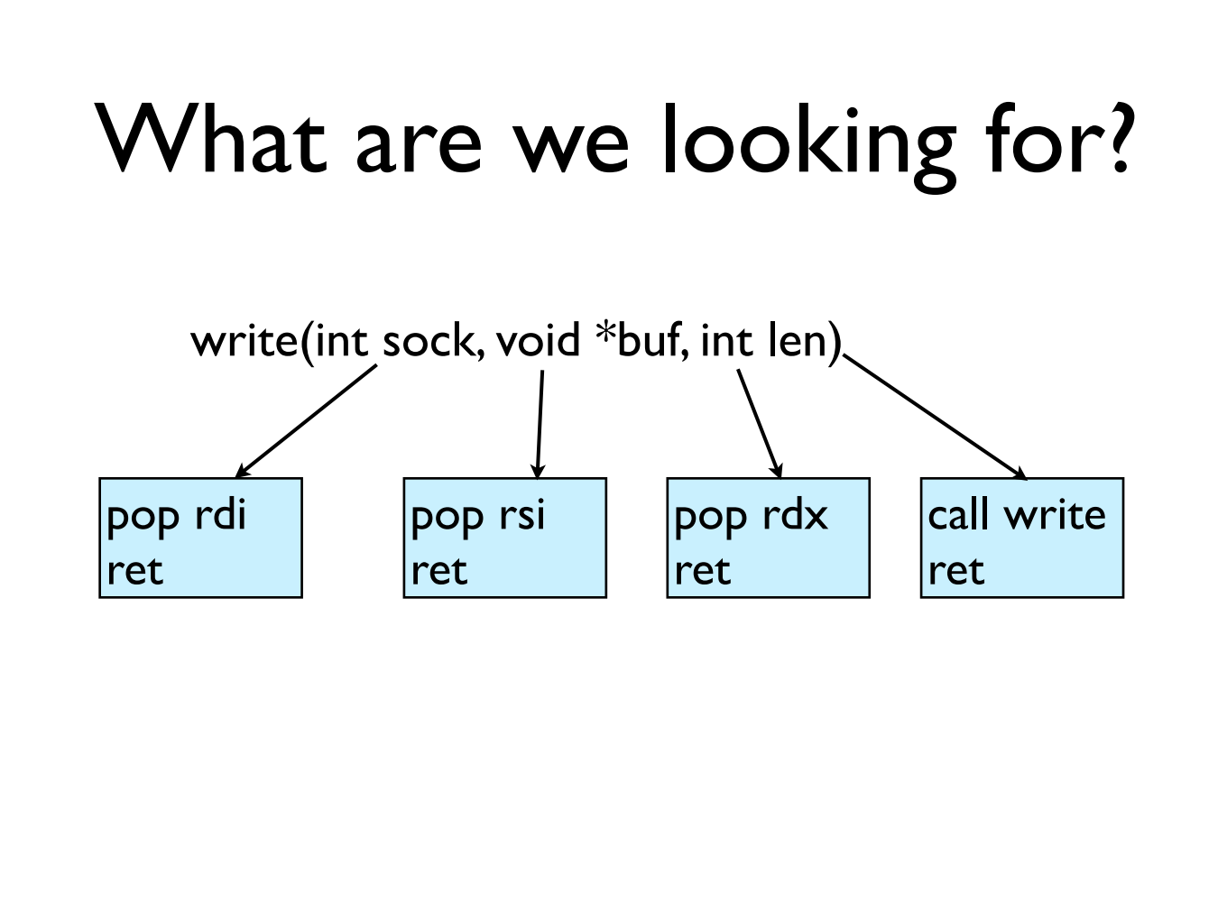

Slide 106
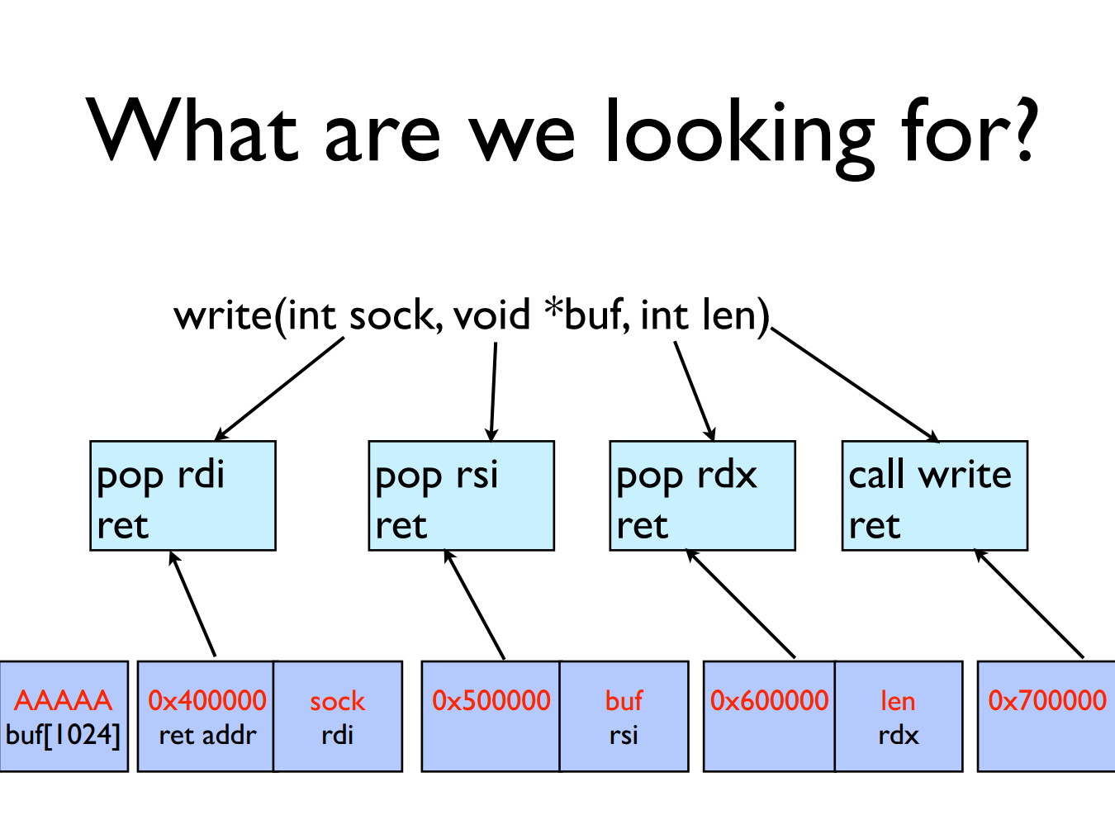

Slide 107
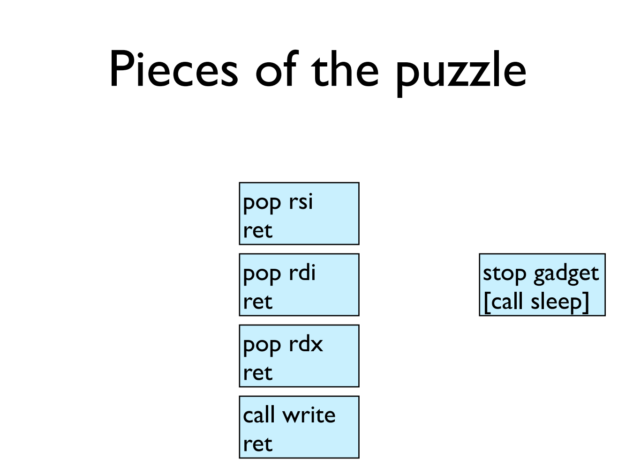

Slide 108
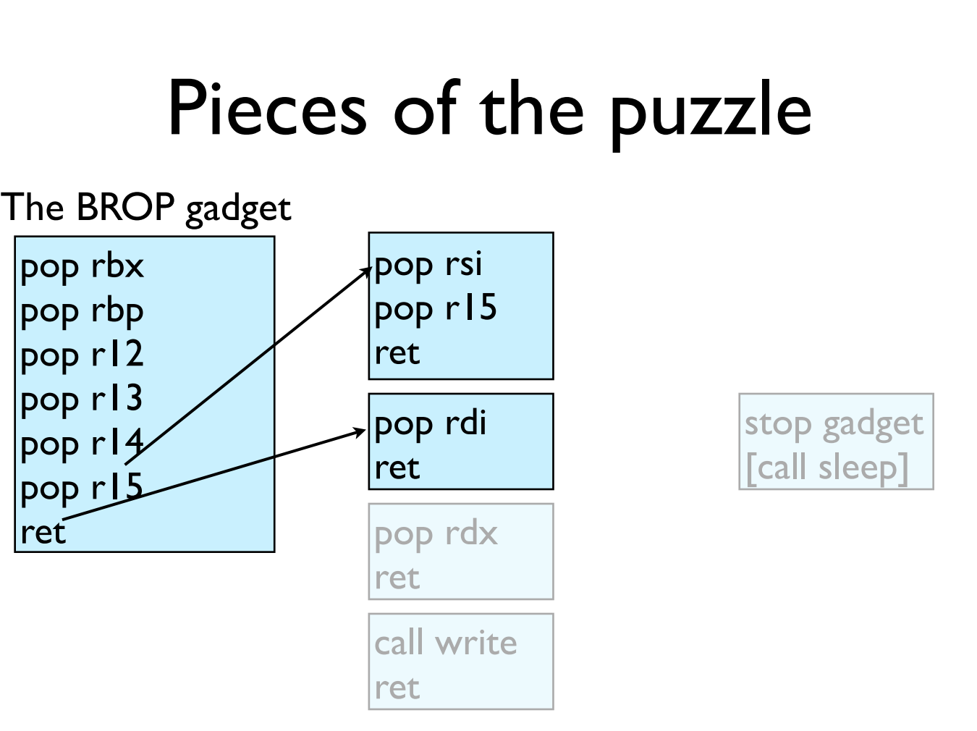

Slide 109
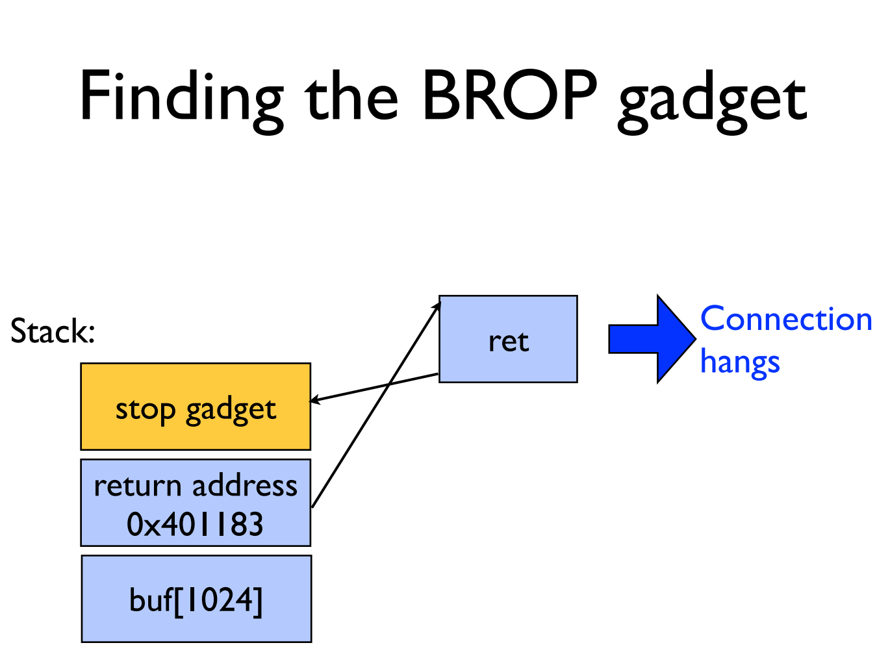

Slide 110
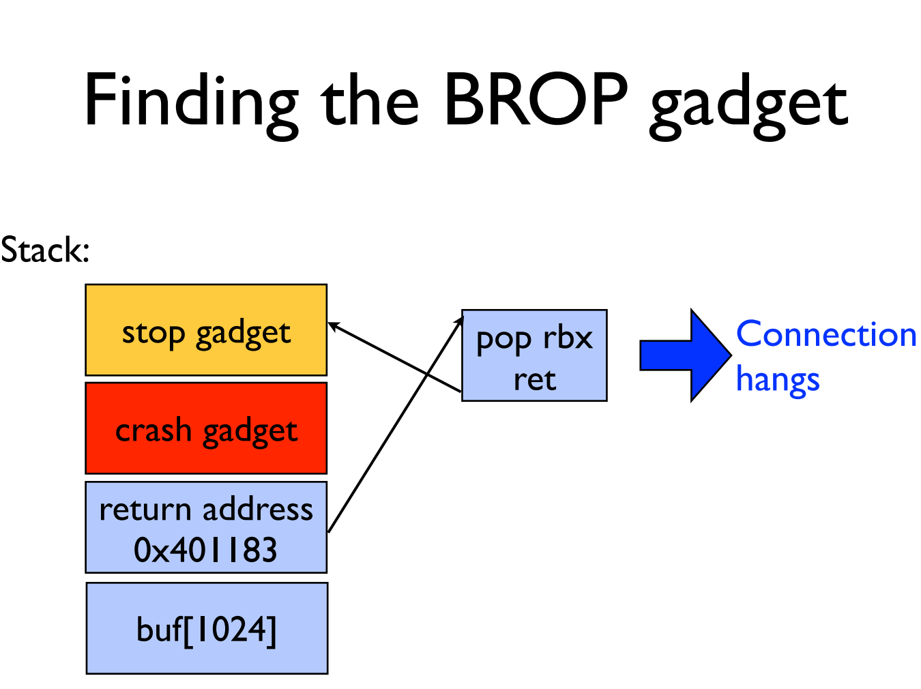

Slide 111
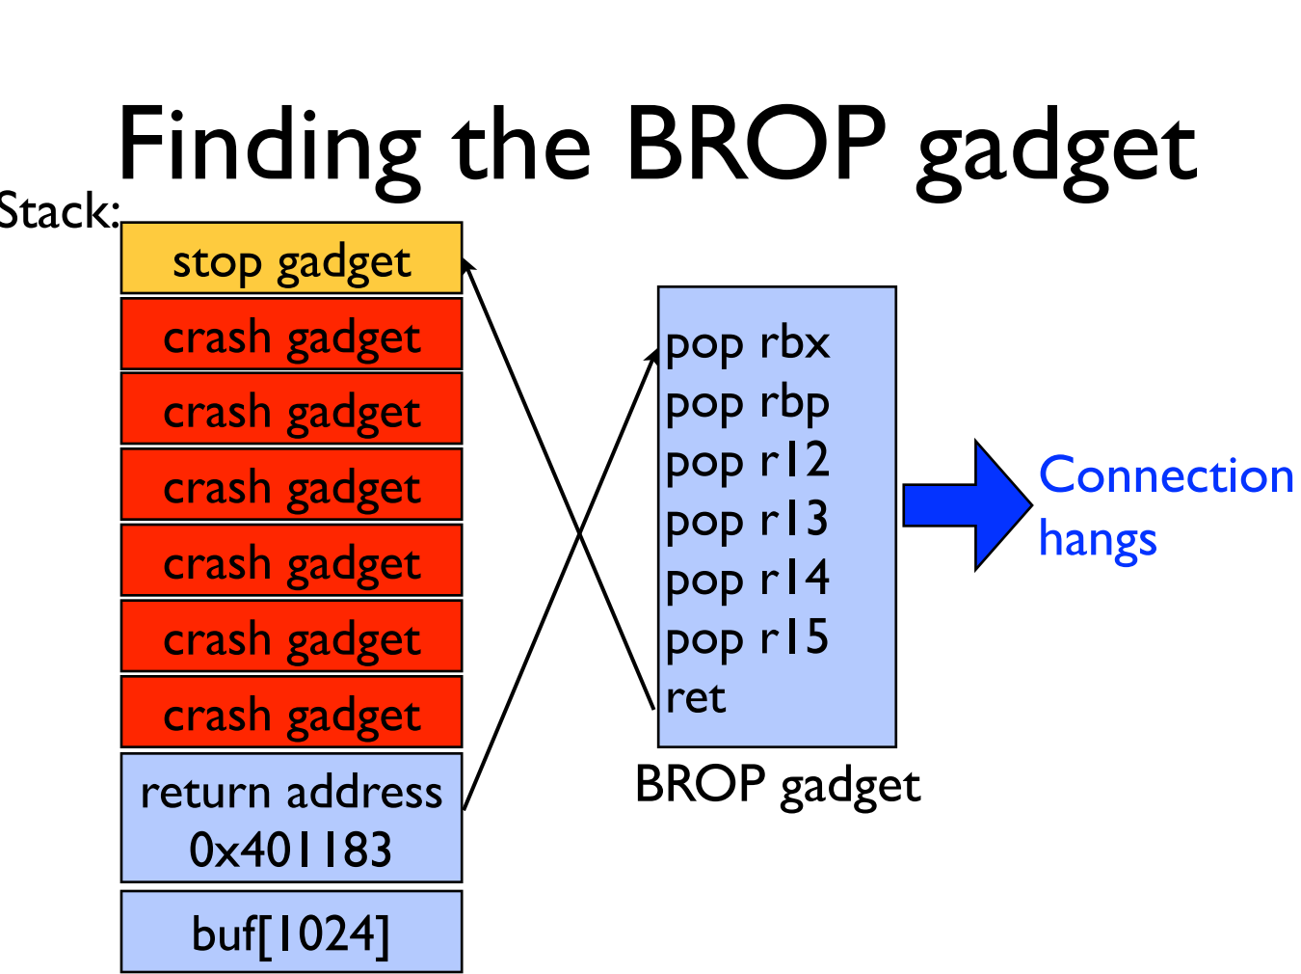

Slide 112


Slide 113


Slide 114


Slide 115


Slide 116
GOT & PLT
Jump to the address that this entry of the GOT contains:
First time: call to dynamic linker and write the function address to GOT
Not first time: the GOT already contains the address that points to printf.
PLT
printf() call
Dynamic linker
libc
GOT

Slide 117

Notes:
另外，大部分的PLT项都不会因为传进来的参数的原因crash，因为它们很多都是系统调用，都会对参数进行检查，如果有错误会返回EFAULT而已，并不会造成进程crash。所以攻击者可以通过下面这个方法找到PLT：如果攻击者发现好多条连续的16个字节对齐的地址都不会造成进程crash，而且这些地址加6得到的地址也不会造成进程crash，那么很有可能这就是某个PLT对应的项了。

Slide 118


Slide 119

Notes:
1. 同时调用好几次write，把它们串起来，然后传入不同的文件描述符数；2. 同时打开多个连接，然后使用一个相对较大的文件描述符数字，增加匹配的可能性。

Slide 120


Slide 121


Slide 122


Slide 123


Slide 124
Try It!
http://www.scs.stanford.edu/brop/
More information
S&P'14 paper: http://www.scs.stanford.edu/brop/bittau-brop.pdf
Blog: http://drops.wooyun.org/tips/3071

